Slide 1
Today’s Warm-Up
You need a sheet of paper.
Title the assignment:
01/31/2014 Warm-Up: 1st Semester Review, Part 2
Number the page in the upper righthand corner:
U8-4
There are six (6) questions:
Write the question (in shortened form).
Then, write the correct answer.

Slide 2
1st Semester Review
The atomic radius __________ as you move down a group (top to bottom) and __________ as you move across a period (left to right).
increases, increases
increases, decreases
decreases, decreases
decreases, increases
Notes:
Fall 2013 MC Final Exam – Question #32
Answer: b

Slide 3
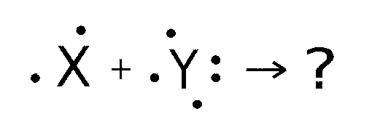
1st Semester Review
The correct formula resulting from the two atoms shown below is __________.
X₂Y₅
X₂Y₃
X₅Y₂
X₃Y₂
Notes:
Fall 2013 MC Final Exam – Question #36
Answer: d

Slide 4
1st Semester Review
Molecular compounds are usually _______________.
composed of two or more transition elements
composed of positive and negative ions
composed of two or more nonmetallic elements
exceptions to the law of definite proportions
Notes:
Fall 2013 MC Final Exam – Question #46
Answer: c

Slide 5
1st Semester Review
A physical property of ionic compounds in their solid state is __________.
electrical conductivity
weak attractive forces between ions
a low boiling point
a high melting point
Notes:
Fall 2013 MC Final Exam – Question #47
Answer: d

Slide 6
1st Semester Review
Use the following equation:
___C₈H₁₈(l) + ___O₂(g) → ___CO₂(g) + ___H₂O(g)
The coefficients needed to balance this equation are __________.
1, 1, 1, 1
1, 17, 8, 18
2, 25, 16, 18
2, 12.5, 8, 9
(1)
12.5
8
9
2
25
16
18
Notes:
Fall 2013 MC Final Exam – Question #67
Answer: c

Slide 7
1st Semester Review
Use the following equation:
___C₈H₁₈(l) + ___O₂(g) → ___CO₂(g) + ___H₂O(g)
As the reaction occurs, the total mass __________.
increases
decreases
stays the same
doubles
2
25
16
18
Notes:
Fall 2013 MC Final Exam – Question #69
Answer: c

