Slide 1
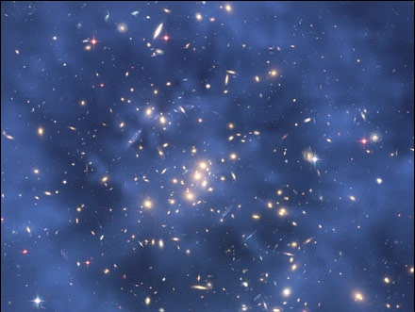
Unit 1 Measurement
Module 1
Introduction

Slide 2
The universe is made of matter and energy.

Slide 3
Chemistry
The study of matter, as well as the changes it undergoes and the energy changes that accompany such transformations
Reaction of sulfuric acid and sugar. The acid dehydrates the sugar forming a pillar of carbon (black substance) and steam.
Reproduced with permission of Photo Researchers, Inc.

Slide 4
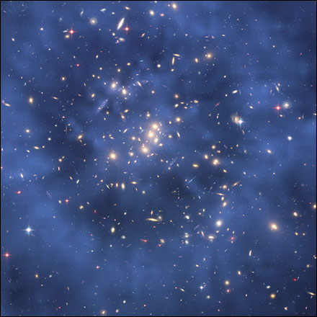
Matter
Anything that has mass and volume
Hubble Space Telescope composite image showing what may be a ring of dark matter in the galaxy cluster Cl 002417.
Image: NASA, ESA, M. J. Jee and H. Ford (John Hopkins University)

Slide 5
Matter can be macroscopic.
Visible without a microscope

Slide 6
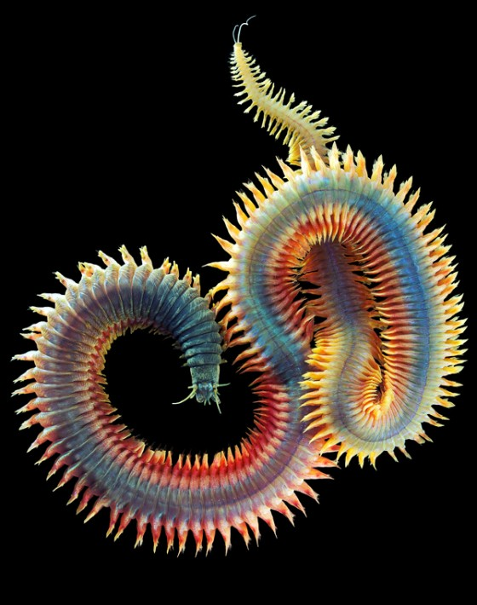
Matter can be microscopic.
Visible with a microscope
Alexander Semenov
www.bloodyloud.com

Slide 7
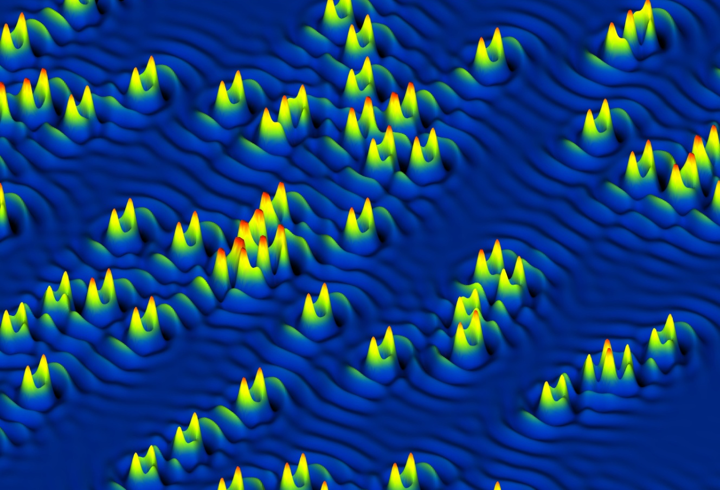
Matter can be submicroscopic.
Not visible, even with a microscope (light microscope)
Substitution of cobalt atoms into crystal framework of iron-based material
Scanning tunneling microscopes, developed in 1981, image and manipulate individual atoms within materials

Slide 8
Matter can be submicroscopic.
Matter studied by chemistry is primarily submicroscopic.
To understand matter at the submicroscopic level:
we study macroscopic behavior, composition, and structure
we use models
Substitution of cobalt atoms into crystal framework of iron-based material
model: three-dimensional representation containing the essential structure of some object or event in real world

Slide 9
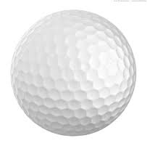
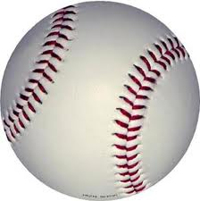
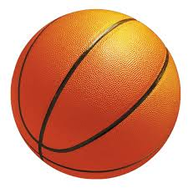
Volume
Measurement of the amount of space occupied by a sample of matter
golf ball
baseball
basketball

Slide 10
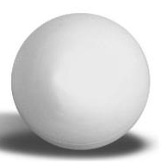
Mass
Measurement reflecting the amount of matter
Can also be defined as the amount of inertia in an object
Inertia is the resistance to change
Therefore, mass characterizes an object’s resistance to a change in motion
The more mass in an object, the greater its resistance to change
Compare:
ping pong ball
golf ball

Slide 11
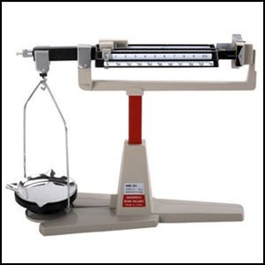
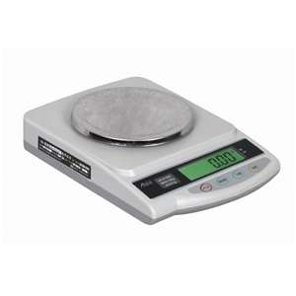
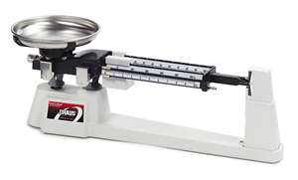
Mass
Measured by an instrument called a balance
The unit for mass is the gram (g)
Triple Beam Balance
Four Beam Balance
Electronic Balance

Slide 12
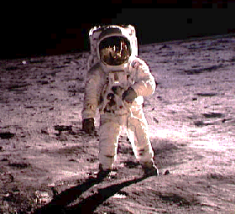
Mass vs. Weight
The Mass vs. Weight Song

Slide 13
Mass vs. Weight
Mass measures the amount of matter
Weight measures the gravitational pull on matter

Slide 14
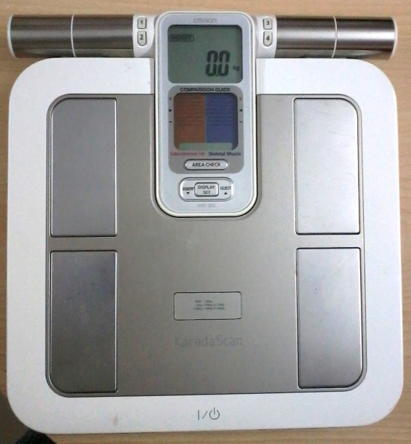
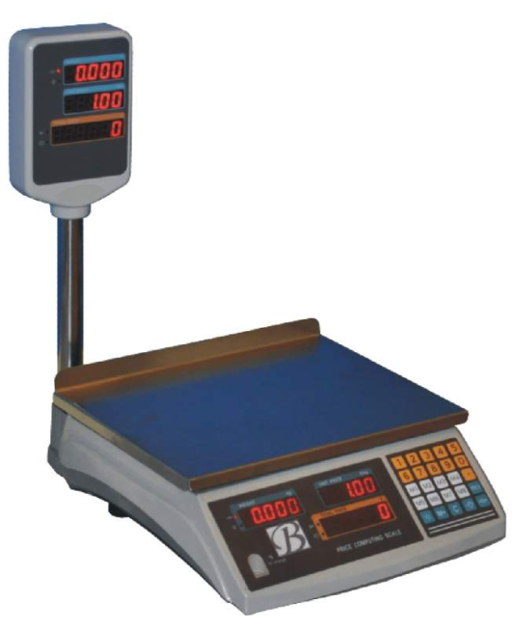
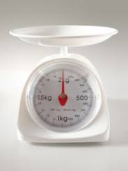
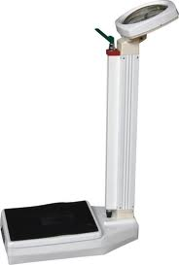
Weight
Measured by an instrument called a scale
The unit for weight is the newton (N)

Slide 15
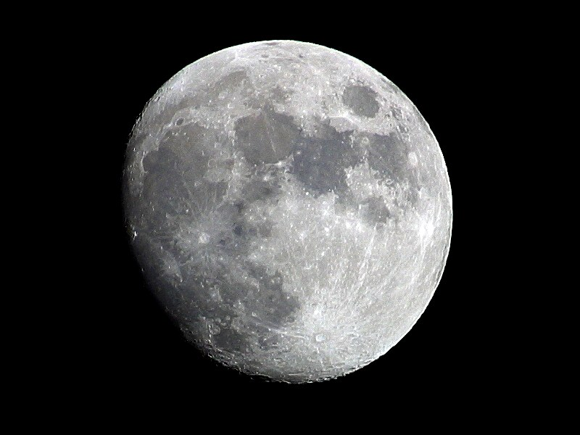
The gravity on the Moon is 1/6 that
on Earth. If a person weighs
120 pounds
on Earth,
how much
would she
weigh on the Moon?
How would her mass on the Moon compare to her mass on Earth?

Slide 16
Unit 1 Measurement
Module 1
Introduction

