Slide 1
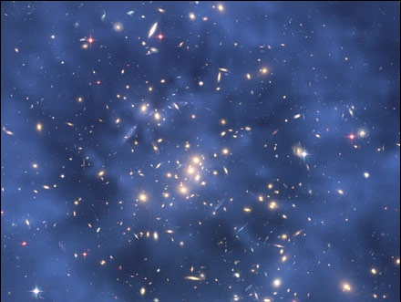
Unit 2 Matter
Module 3
Properties and Changes

Slide 2
Physical Properties
Characteristics observed through five senses or measured without changing composition or identity of matter
Consistent and unchanging due to the uniform and unchanging compositions of pure substances

Slide 3
Two Types
Extensive Properties
Intensive Properties
Depend upon amount of substance present
Examples:
Mass
Length
Volume
Independent of amount of substance present
Examples:
State at room temperature
Color, odor, taste, hardness
Density, melting/boiling points
Malleability, ductility
Electrical/thermal conductivity

Slide 4
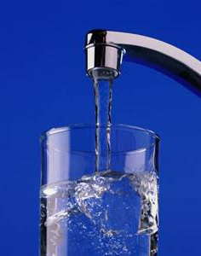
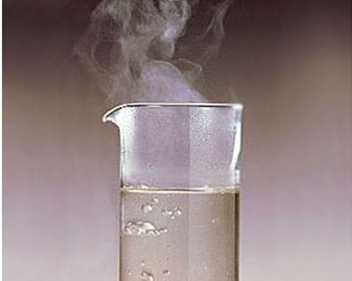
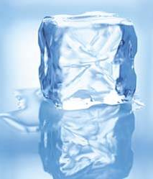
What are some physical properties of water?

Slide 5
Chemical Properties
The ability – or the inability – of a substance to combine with or change into one or more other substances
Evident when substances come in contact with each other or when energy is applied

Slide 6
Chemical Properties
The ability to:
rust
corrode
burn
explode
rot
change color
react
or the inability to do these things

Slide 7
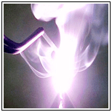
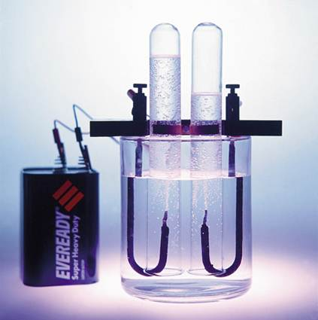
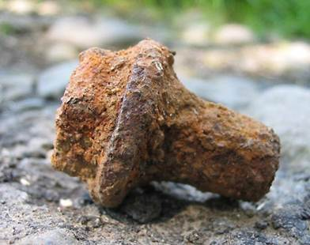
Examples
The ability of water to decompose into hydrogen and oxygen
The ability of iron to rust when combined with oxygen
The ability of magnesium to burn in the presence of oxygen

Slide 8
Properties
Substances have unique sets of physical and chemical properties
Helpful in identifying unknown substances

Slide 9
Physical Changes
Changes which alter a substance without changing its composition or identity

Slide 10
Physical Changes
Cut, break, bend, grind, crumple, split, crush, dissolve, fold
Include phase changes: most substances undergo change from one state of matter to another as temperature and pressure conditions change
Melt, freeze, boil, vaporize, condense

Slide 11
Chemical Changes
Processes involving one or more substances changing into new substances
Also referred to as chemical reactions

Slide 12
Chemical Changes
Starting substances [reactants] have different compositions and properties from new substances formed [products]
Represented by chemical equations
Reactants → Products

Slide 13
Chemical Changes
Explode
Rust
Oxidize
Corrode
Tarnish
Ferment
Burn
Rot

Slide 14
Evidence/Indicators of Chemical Reaction
Formation of a gas
Formation of a solid (precipitate)
Change in temperature or energy
Change in smell or production of odor
Change in color
Change in magnetism

Slide 15
Law of conservation of matter
Mass is neither created nor destroyed in any physical or chemical process; it is conserved.

Slide 16
Law of conservation of matter
Mass_{reactants} = Mass_{products}

Slide 17
Applying the Law
When a 15-g sample of X reacts with a 25-g sample of Y, how much of the product XY can be formed?
X + Y → XY
15 g 25 g ? g
mass
reactants
mass of
products
40. g
reactants
mass of
products
40. g
reactants
40. g
products

Slide 18
Unit 2 Matter
Module 3
Properties and Changes

