Slide 1
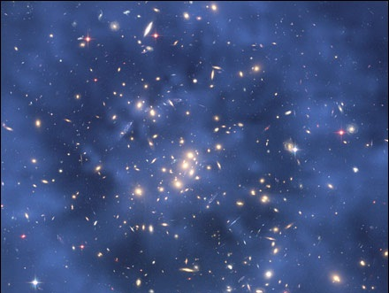
Unit 2 Matter
Module 4
Classification of Matter by Composition

Slide 2
Matter
Mixture
Heterogeneous
Substance
Element
Suspension
Colloid
Homogeneous
Compound
Solution

Slide 3
MATTER Defined
Anything that has mass and volume

Slide 4
Composition of Matter
Constant composition?
Variable composition?
Substance
Mixture

Slide 5
Matter
Mixture
Substance

Slide 6
Substances or Chemicals
Constant Composition
Definite and uniform composition with distinct properties
Made of single type of atom or molecule
Chemical formula can be written

Slide 7
Mixture
Variable Composition
Combination of two or more substances, which retain their identities and characteristic properties
Composition varies from one sample to another and can vary within a single sample
Made of two or more types of atoms or molecules that are physically combined
Two parts:
Dispersed phase: present in lesser amount
Dispersing medium: present in greater amount

Slide 8
Matter
Mixtures
Substance

Slide 9
Matter
Mixtures
Substance
Element
Compound

Slide 10
Elements
Basic building blocks of matter: cannot be broken into simpler substances through physical or chemical means
118 known elements are found on Periodic Table, organized by physical and chemical properties
#1 thru #92 occur naturally
> #92 are synthetic
Contain only one type of atom: one name, one unique symbol

Slide 11
Compounds
Composed of two or more substances chemically combined in definite ratios
Have unique names and symbols
Chemical combination results in molecules or arrays of ions
Can be broken down by chemical means, which require energy (heat or electricity)
Properties of compounds are distinctly different from properties of unbonded elements

Slide 12
Matter
Mixtures
Heterogeneous
Pure Substances
Elements
Homogeneous
Compounds

Slide 13
Heterogeneous Mixtures
Non-uniform mixture of two or more substances, existing in more than one phase
Components are distinguishable (distinct) and separate into phases (such as, oil and water)
Tend to have cloudy appearance and particles settle into layers over time
Positive for Tyndall effect

Slide 14
Tyndall Effect
Phenomenon in which particles of a mixture scatter light
Positive: beam of light can be seen when passed through heterogeneous mixtures
Negative: light is not visible when passed through homogeneous mixtures

Slide 15
Matter
Mixture
Heterogeneous
Substance
Element
Homogeneous
Compound

Slide 16
Matter
Mixture
Heterogeneous
Substance
Element
Suspension
Colloid
Homogeneous
Compound

Slide 17
Suspensions
Largest particle size
Particles are usually visible and can be separated by filtration or centrifuging

Slide 18
Colloids
Intermediate particles are not completely dissolved
Particles remain suspended and cause mixture to appear cloudy
Particles do not filter out and do not settle into layers

Slide 19
Colloids
Classified as aerosols or foams when involving gases
Emulsions, sols, and gels involve solids and liquids

Slide 20
Matter
Mixture
Heterogeneous
Substance
Element
Suspension
Colloid
Homogeneous
Compound

Slide 21
Homogeneous Mixtures
Uniform composition existing in single phase
Composition is variable from one mixture to another
Composition is uniform within individual mixture
Clear, transparent when in liquid phase
Can contain solids, liquids, and gases
Alloys are solid in solid solutions
Air is mixture of gases
Soft drinks are made of solids, liquids, and gases

Slide 22
Matter
Mixture
Heterogeneous
Substance
Element
Solution
Suspension
Colloid
Homogeneous
Compound

Slide 23
Solutions
Homogeneous mixtures are also known as solutions
Consist of solute and solvent
Water is universal solvent forming aqueous solutions
Made of multiple substances that appear identical because particles are so small and are mixed uniformly

Slide 24
Solutions
Components are indistinguishable and do not separate into layers
Cannot be separated by filtration or centrifuging

Slide 25
Matter
Mixture
Heterogeneous
Substance
Element
Solution
Suspension
Colloid
Homogeneous
Compound

Slide 26
Unit 2 Matter
Module 4
Classification of Matter by Composition

