Slide 1
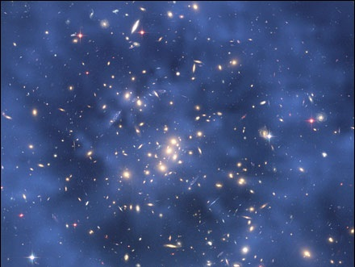
Unit 2 Matter
Module 5
Separation of Mixtures

Slide 2
Separation Techniques
Physical methods to separate mixtures into their component substances

Slide 3
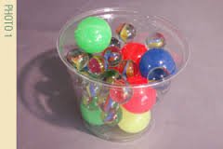
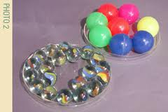
Manual Separation
Manual means “by hand”
Use tool, such as tweezers, to remove and separate components of a mixture
Used with suspensions

Slide 4
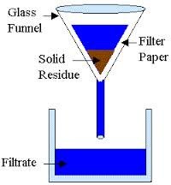
Filtration
Uses a porous barrier to separate solids from liquids.
Example: Filter paper in a funnel to separate sand from water
Used with suspensions

Slide 5
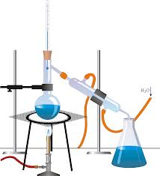
Distillation
Based on the differences in boiling points of substances
Example: When boiling salt water solution, water vaporizes first
Used with solutions, colloids

Slide 6
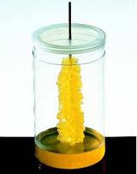
Crystallization
Results in formation of pure solid particles of a substance from a solution
Example: When making rock candy, sugar forms solid crystals as liquid evaporates
Used with solutions

Slide 7
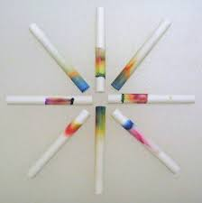
Chromatography
Based on tendency of components of mixture to travel across surface of another material
Example: Separating ink dyes
Used with solutions

Slide 8
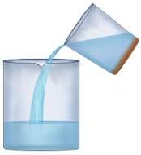
Decantation
Allows a liquid to be separated quickly from a heavier solid
Example: After solid particles of muddy water are allowed to settle, water can be poured off top layer
Used with suspensions

Slide 9
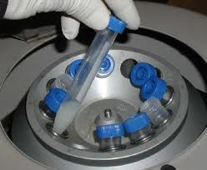
Centrifuging
A centrifuge can be used to separate components of a suspension
Uses centripetal force to separate denser substances along the bottom of a tube while lighter substances move to the top
Example: Blood banks use centrifuges to separate the components of blood

Slide 10
Unit 2 Matter
Module 5
Separation of Mixtures

