Slide 1
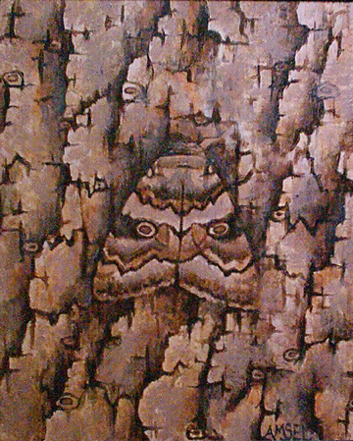
ADAPTATIONS and ECOSYSTEMS
Relationships in Nature

Slide 2
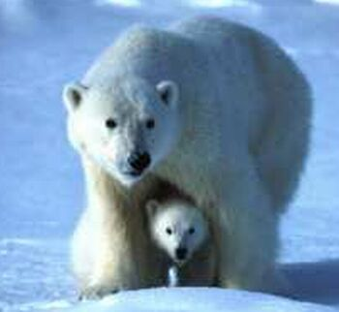
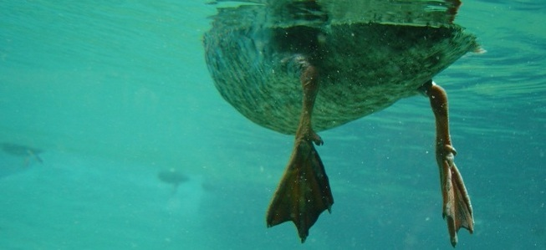
Adaptation
A trait that makes an organism able to survive in its surroundings
Controlled by genes
Examples
Webbed feet on a duck to help it swim
White fur on a polar bear to help it blend in with the snow

Slide 3
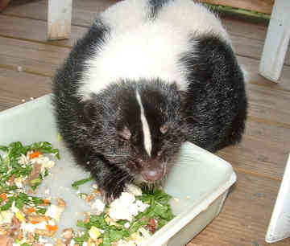
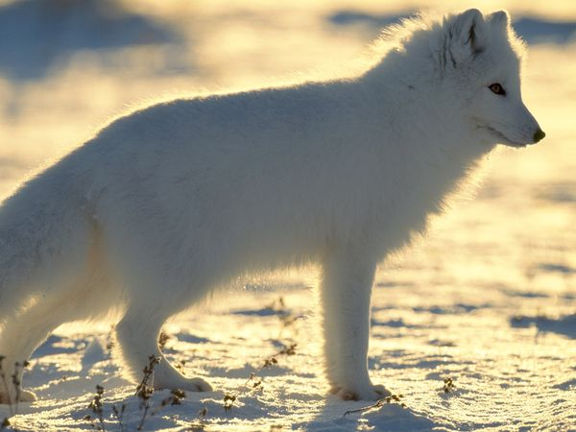
Adaptation
A trait that makes an organism able to survive in its surroundings
Controlled by genes
Examples
Extra fur on an animal to survive the cold
Scent of a skunk to ward off enemies

Slide 4
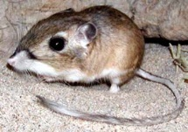
Adaptation: Desert Rat
Lives in a dry environment , so it is important for the desert rat to retain water
Excretes very concentrated urine
Diet consists of seeds, plants, and insects
Gets all of its water from food

Slide 5
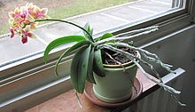
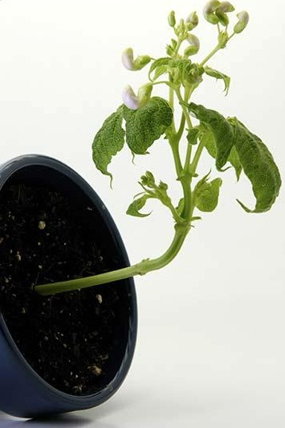
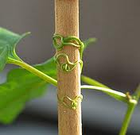
Plant Adaptations
Phototropism: movement of plant toward light
Geotropism: root growth of plants toward gravity (down) while top grows up
Thigmotropism: directional response of a plant to touch

Slide 6
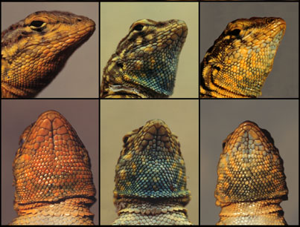
Natural Selection
Process by which a factor in a living thing’s surroundings determines if it will survive in order to reproduce offspring
The factor in nature does the selecting
Living things that are better suited to their environment are most likely to reproduce

Slide 7
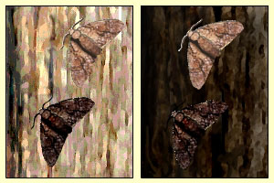
Natural Selection: Pepper Moths
During Industrial Revolution, smoke killed lichens growing on trees and blackened their bark
Pale-colored moths, which had been well camouflaged, became more conspicuous and were eaten by birds
Rare dark moths were now better camouflaged
The next generation had more dark moths

Slide 8
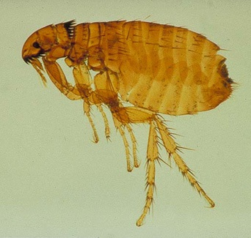
Symbiosis
Relationship between species living in direct contact with each other
Involves exchange of benefits – cooperation and competition co-exist
Parasitism: one species benefits while the other is harmed
For example, food or shelter is exchanged for decrease in warmth and reproduction.
Fleas on a dog
Bacteria or viruses in the human body

Slide 9
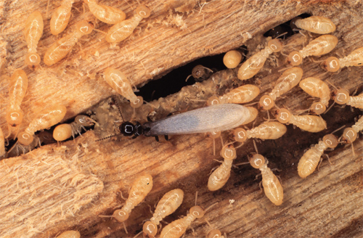
Symbiosis
Mutualism: both species benefit from each other
For example, the human body provides a home for bacteria
The bacteria in the human intestine provides the body with Vitamin B12
Termites are able to eat a dead log because protozoa in their intestines digest the cellulose

Slide 10
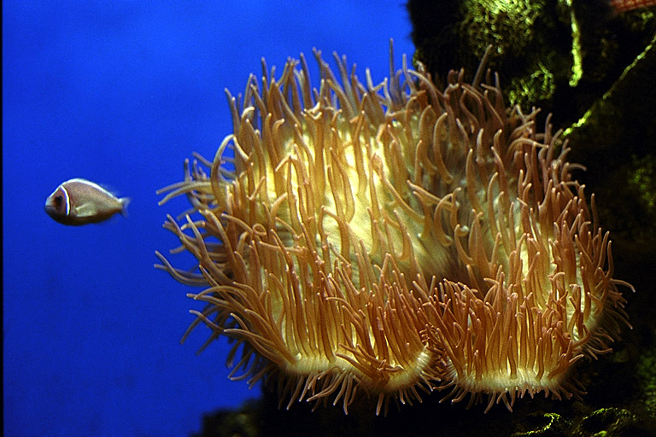
Symbiosis
Commensalism: one species benefits and the other is unaffected
The sea anemone provides food and shelter for the fish.
The fish provides nothing for the sea anemone.

Slide 11
Quick Quiz #1
A trait that makes a living thing able to survive in its surroundings is a(n) _______________.
Give three examples of adaptations.
Duck’s webbed feet, white fur to blend with snow, extra fur in winter, scents
Process by which a factor in a living thing’s surroundings determines if it will survive in order to reproduce offspring is __________ ____________.
Explain how bacteria become resistant to antibiotics.
Resistant bacteria survive to produce offspring. The next generation inherits this resistance.
adaptation
natural selection

Slide 12
Quick Quiz #2
In parasitism, one species benefits, and the other is _________.
In mutualism, both species _______ each other.
In commensalism, one species benefits, and the other species is ____________.
Give an example of each type of symbiosis.
Parasitism: flea or tick on animal
Mutualism: bacteria in intestines
Commensalism: sea anemone and fish
harmed
benefit
unaffected

Slide 13
Ecosystem
Ecosystem: ecological system encompassing a community and all the physical aspects of its habitat
Community: groups of different species living together; collection of interacting and dependent populations
Population: group of organisms of same species that interbreed and live together in the same place at the same time
Habitat: place/location where an organism lives
Niche: role or “occupation” of an organism within its habitat

Slide 14
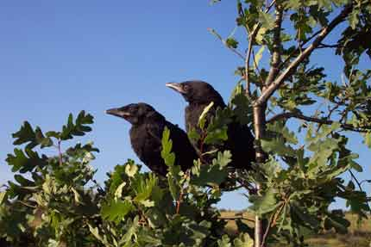
Communities
Cooperation
Competition
Populations within a community interact with and assist other populations for resources (food, water, space, shelter, light and mates)
Different populations try to occupy the same environment and end up competing for resources
Trees in a forest for sunlight
Herbivores eating different plants or different parts of a plant

Slide 15
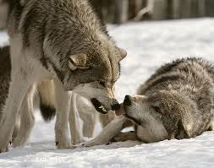
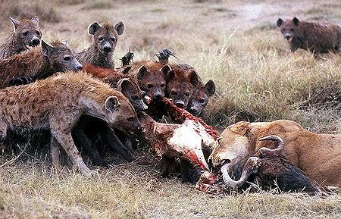
Competition
Intraspecific
Interspecific
Competition among members of the same species
Dominance hierarchy – the fight to be the alpha male
Competition between different species
Lions fighting hyenas for the catch of the day

Slide 16
Competition
No two species can occupy the same niche in the same habitat at the same time
Direct competition in nature results in a winner and a loser
Winners live, while losers die
Or, at least move somewhere else

