Slide 1
Ecological Changes

Slide 2
Changing Food Webs
Short-term changes have temporary effects
Example: shortage of rain may cause a river bed to dry up but the plant and animal life survives
Permanent changes in conditions can lead to extinction of animals
Animals adapt to their environments
Example: Worms like dark, damp conditions.

Slide 3
Changing Food Webs
Reasons for change:
Predation
Predators eat smaller animals, meaning the smaller animals need to breed more quickly
Disease
Disease can produce a lack of one type of animal in a given area, thus affecting the other types of animals
Competition
The introduction of one animal to an area can lead to a decrease in the population of other animals
Example: Red squirrel population in Britain has decreased since the grey squirrel was introduced

Slide 4
Changing Food Webs
Reasons for change:
Human Action
Activities of human beings affect terrestrial and marine food webs
Example: cutting down forests affects animals in these habitats; fish farming in Scotland has affected populations of sea animals
Disasters
Oil pollution, radiation, industrial waste

Slide 5
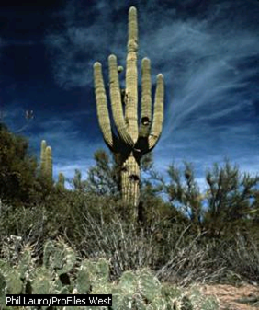
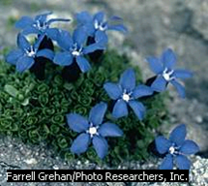
Environmental Factors
Factors affecting where animals and plants will be found:
Temperature of environment
This cactus found in Arizona grows to a height of 12 feet. It stores every available amount of water.
The spring Gentian is famous for its blue flowers and grows where the temperature is low.

Slide 6
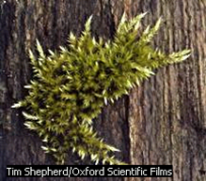
Environmental Factors
Factors affecting where animals and plants will be found:
Humidity of air
Mosses are simple plants that do not have the ability to absorb water. They are found in damp places.

Slide 7
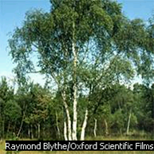
Environmental Factors
Factors affecting where animals and plants will be found:
Light intensity
The amount of light in an environment is measured with a light meter similar to that used with a camera.

Slide 8
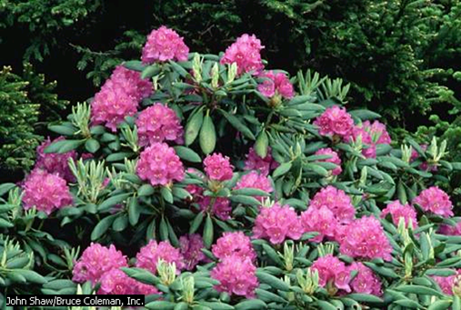
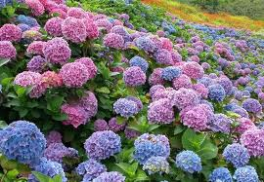
Environmental Factors
Factors affecting where animals and plants will be found:
pH
The color of hydrangeas changes from pink to blue depending upon the acidity of the soil.
The acidity of the soil can be measured with pH paper. The soil in high rainfall areas tends to be acidic. Plants like rhododendrons and azaleas grow in acidic soil.

Slide 9
Environmental Factors
Factors affecting where animals and plants will be found:
Water flow rate
The flow rate of moving water can be measured using a cork and determining how fast it flows in a stream.

Slide 10
High Water Flow Rate
Animals living in fast-moving streams end to have streamlined bodies to cope with the high flow rate.

Slide 11
Low Water Flow Rate
These animals can survive in stiller waters.

Slide 12
Environmental Factors
Factors affecting where animals and plants will be found:
Wind flow rate
How fast the wind is blowing in a certain area is measured with a wind speed gauge.
Some trees become windswept, and in windy conditions, some trees will not grow at all.

Slide 13
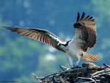
Population Change
Populations of different living things are found within each habitat.
Population: the number of a particular species in a certain area
Climate affects population
Example: The Osprey migrate to Africa in the winter to return to breed each spring.

Slide 14
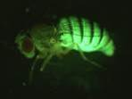
Population Change
Factors affecting population change:
Predators
During the 1970s, huge numbers of ladybugs appeared.
The change in ladybug numbers was due to an increase in the population of the greenfly.
The increase in food for ladybugs allowed their population to grow.

Slide 15
Population Change
Factors affecting population change:
Competition
Competition for space: Ladybug overcrowding was so bad that, in some places, they covered the ground

Slide 16
Population Change
Factors affecting population change:
Disease
Spreads quickly through large, dense populations but slowly through smaller populations.

Slide 17
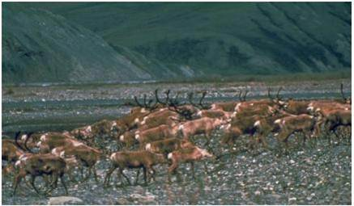
Population Change
Factors affecting population change:
Migration
Birds flying south during cold weather months can cause seasonal changes in population

Slide 18
Population Change
Factors affecting population change:
Climate
Changes in weather can cause changes in populations
Dinosaurs may have disappeared due to climate change.

Slide 19
Population Change
Factors affecting population change:
Climate
Changes in weather can cause changes in populations
The Osprey migrate to Africa in the winter to return to breed each spring.

Slide 20
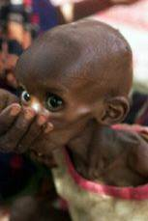
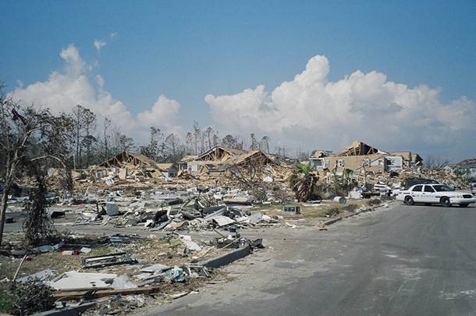
Population Change
Factors affecting population change:
Floods and famine
Both factors can change where people and animals live
Aftermath of Hurricane Katrina

