Slide 1
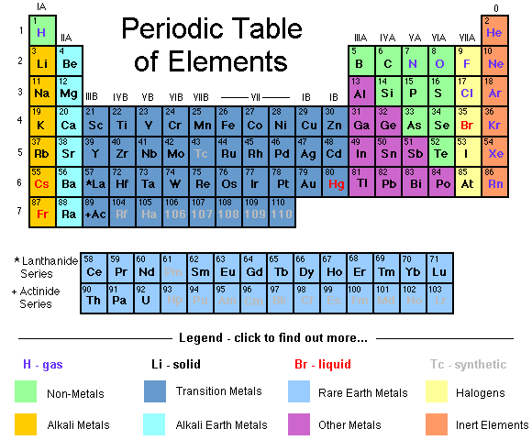
History of the Periodic Table

Slide 2
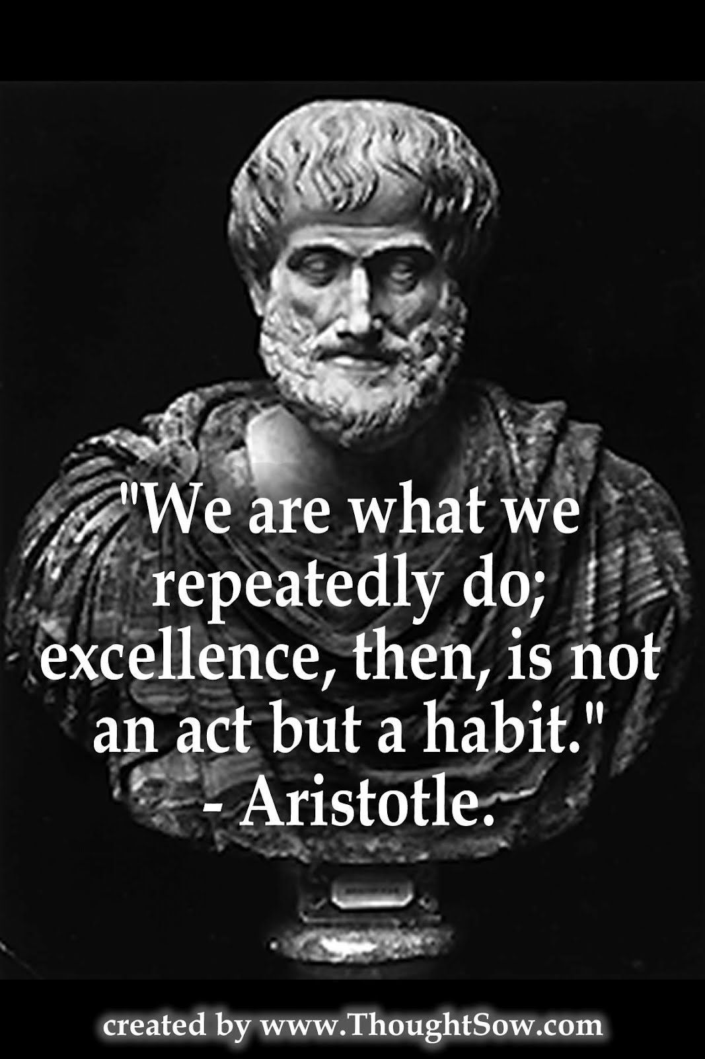
Aristotle
Circa 300 B.C.
Greek philosopher and polymath (person whose expertise spans significant number of different subject areas)
Four element theory:
Earth
Air
Fire
Water

Slide 3
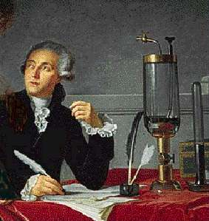
Antoine Lavoisier
1770-1789
Known as Father of Modern Chemistry
Compiled list of 23 to 32 elements
Some elements were later shown to be compounds

Slide 4
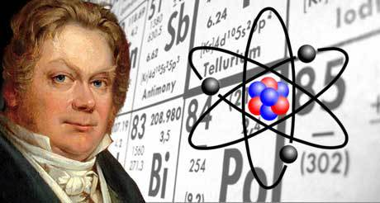
Jöns Jakob Berzelius
1828
Developed table of atomic weights (AKA atomic mass)
Introduced element symbols
Experiments led to discovery of new elements (cerium, selenium, thorium)

Slide 5
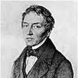
Johann Döberiener
Ca Sr Ba
40 137
88
Hmmm…what element has a mass of 88 and similar properties to Ca and Ba?
Calcium, strontium, and barium possess similar chemical properties
Döbereiner noticed the atomic weight of strontium fell midway between those of calcium and barium
(40 + 137) ÷ 2 = 88
Was this merely a coincidence or did some pattern to the arrangement of the elements exist?

Slide 6
Johann Döberiener 1829
Classified groups of elements into triads
Three elements with similar physical and chemical properties
Led to idea of groups (columns in Periodic Table)
Döberiener’s Law of Triads
1780-1849

Slide 7
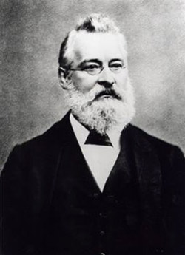
John Newlands
Arranged about 60 known elements by increasing atomic weight
Noted that, after interval of eight elements, similar physical/chemical properties reappeared
1864
Proposed the Law of Octaves based on observed similarities between elements
Led to the idea of periods (rows in Periodic Table)
1838 - 1898

Slide 8
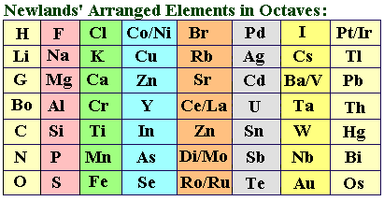

Slide 9
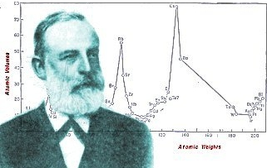
Lothar Meyer
1869-1870
Graphed atomic volumes vs. atomic weights
Compiled periodic table of 56 elements based on periodicity of properties when arranged in order of atomic weight

Slide 10
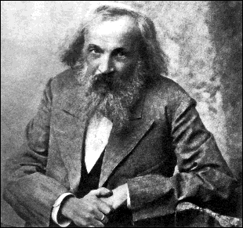
Dmitri Mendeleev 1869-1870
Produced periodic table based on atomic weights and arranged elements with similar properties under each other
Known as the Father of the Periodic Table
1834-1907

Slide 11
Known Elements
Mendeleev used his table to predict physical properties of three unknown elements
Mendeleev stated that if the atomic weight of an element caused it to be placed in the wrong group, then the weight must be wrong.
Mendeleev’s predictions fo scandium, gallium, and germanium were amazingly close to the actual values
These unknown elements were discovered between 1874 and 1885
He corrected the atomic masses of beryllium, indium, and uranium

Slide 12
However, problems arose when new elements were discovered and more accurate atomic weights determined
Looking at the modern periodic table, what problems might have caused chemists a headache?
Ar and K
Co and Ni
Te and I
Th and Pa

Slide 13
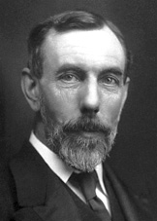
William Ramsay 1894
Discovered the noble gases
1852-1916

Slide 14
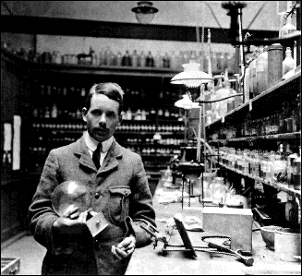
Henri Mosely
Worked with X-rays and determined the actual nuclear charge of elements
“There is in the atom a fundamental quantity which increases by regular steps as we pass from each element to the next. This quantity can only be the charge on the central positive nucleus.”
1887-1915

Slide 15
Henri Mosely 1913
Determined atomic numbers of elements
Modified periodic law to read that properties of elements vary periodically with atomic number
Concluded 92 elements existed, up to and including uranium
1887-1915

Slide 16
Periodic Law
There is a periodic repetition of chemical and physical properties of elements when they are arranged by increasing atomic number.

Slide 17
Henri Mosely
His research halted when Britain sent him to serve as a foot soldier in WWI
At the age of 28, Mosely was killed by a sniper’s bullet at Gallipoli
The British government restricted scientists to noncombatant duties during WWII
1887-1915

Slide 18
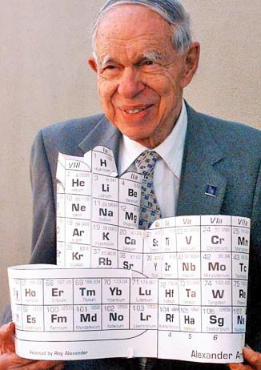
Glenn T. Seaborg 1940s
Synthesized ten transuranium elements
Atomic numbers 94 thru 102 and 106
Developed actinide series
Moved 14 elements out of the main body of the periodic table to its current location below the Lanthanide series
Actinide
Series
1912 - 1999

Slide 19
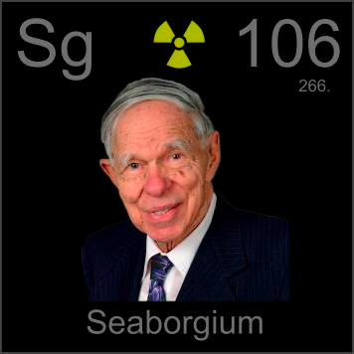
Glenn T. Seaborg
Awarded the 1951 Nobel Prize in chemistry
Element 106 was named Seaborgium (Sg) in his honor
Only person to have an element named after him while still alive
"This is the greatest honor ever bestowed upon me - even better, I think, than winning the Nobel Prize."

Slide 20
Periodic Law
There is a periodic repetition of chemical and physical properties of elements when they are arranged by increasing atomic number

Slide 21
