Slide 1
My Mole Montage
Unit 7: The Mole (Chapter 10)

Slide 2
The mole and avogadro’s number

Slide 3
The Mole Defined
The SI base unit used to measure the amount of a substance
The mole (mol) is a counting unit for the number of representative particles
If you have a dozen doughnuts, how many do you have?
If you have a dozen roses, how many do you have?
If you have a dozen pencils, how many do you have?
Just like the dozen, a mole refers to a specific number of items; the number is constant
Based on the number of atoms in 12 g of C-12
Known as Avogadro’s number

Slide 4
Avogadro’s number
Avogadro’s number –
602,213,670,000,000,000,000,000
Rounded to three significant figures:
6.02 x 10²³
1 mole =
Representative particles are atoms, ions, formula units, or molecules
Avogadro’s number
6.02 x 10²³ representative particles

Slide 5
What does this number mean?
Would 1 mole of rice grains fill this chemistry lab?
1 mole of rice grains would cover the land area of the entire world to a depth of 75 meters
1 mole of rice has more grains
than the number of grains of all grain
grown since the beginning of time!
On the other hand, 1 mole of carbon atoms could fit in your hand

Slide 6
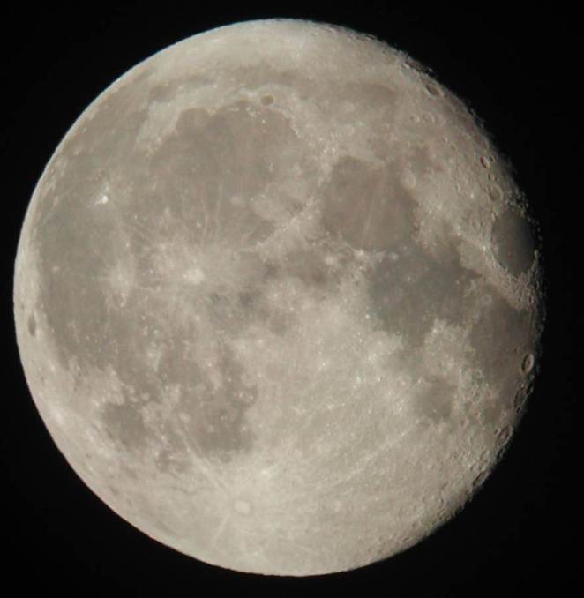
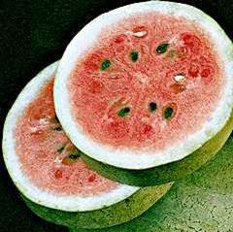
How much is One mole – really?
1 mole of watermelon seeds (6.02 x 10²³ seeds)
would be found in a watermelon slightly larger than . . .
. . . the moon!

Slide 7
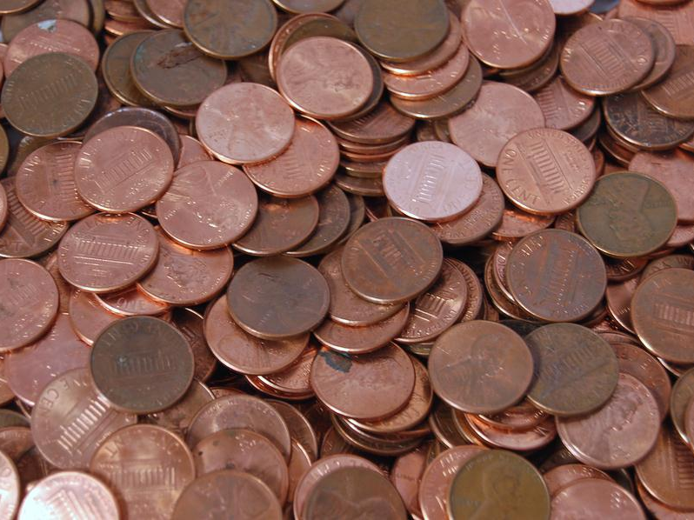
If I had a mole of money …
If one mole of pennies were divided among the Earth’s population, each person would receive 8.6 x 10¹³ (or 86,000,000,000,000) pennies.
Personal spending at the rate of one million dollars per day would use up each person’s wealth in just over 2,350 years.
Life would be a bit uncomfortable though. One mole of pennies would bury the surface of the Earth to a depth of 420 meters!

Slide 8
The mole and avogadro’s number
1 mol = 6.02 x 10²³ representative particles
1 mol K = ___________________________
1 mol Cl– = ___________________________
1 mol NaF = ___________________________
1 mol N₂ = ___________________________
1 mol Cu = ___________________________
1 mol Na+ = ___________________________
1 mol LiCl = ___________________________
1 mol H₂O = ___________________________
6.02 x 10²³ atoms K
6.02 x 10²³ ions Cl–
6.02 x 10²³ formula units NaF
6.02 x 10²³ molecules N₂
6.02 x 10²³ atoms Cu
6.02 x 10²³ ions Na⁺
6.02 x 10²³ formula units LiCl
6.02 x 10²³ molecules H₂O

Slide 9
conversions
Moles to Particles and Particles to Moles

Slide 10
Conversions with moles & particles
1 mol = 6.02 x 10²³ representative particles
The relationship between the mole and Avogadro’s number is the conversion factor
A conversion factor shows the relationship between two different units of measurement

Slide 11
Conversions with moles & particles
1 mol = 6.02 x 10²³ representative particles
The relationship between the mole and Avogadro’s number is the conversion factor
This conversion factor can be expressed as a fraction and may be written in two ways:
The form of the fraction is based on the unit of the GIVEN
1 mole
6.02 x 10²³
representative particles
6.02 x 10²³
representative particles
1 mole

Slide 12
Conversions: Moles to particles
Find the number of atoms in 2.40 mol Cu.
Conversion factor relating atoms (particles) and moles:
(particles)
1 mol =
6.02 x 10²³ representative particles
6.02 x 10²³ atoms
Avogadro’s number
2.40 mol Cu
6.02 x 10²³ atoms Cu
atoms Cu =
1 mol Cu
= 1.4448 x 10²⁴ atoms Cu
= 1.44 x 10²⁴ atoms Cu

Slide 13
Conversions: Moles to particles
How many formula units are in 2.90 mol NaCl?
Conversion factor relating formula units and moles:
(particles)
1 mol =
6.02 x 10²³ representative particles
6.02 x 10²³ formula units
Avogadro’s number
form units =
2.90 mol NaCl
6.02 x 10²³ form unit NaCl
NaCl
1 mol NaCl
= 1.7458 x 10²⁴ formula units NaCl
= 1.75 x 10²⁴ formula units NaCl

Slide 14
Conversions: Moles to particles
Find the number of moles in 1.55 x 10²⁴ ions Ca²⁺.
Conversion factor relating moles and ions:
(particles)
1 mol =
6.02 x 10²³ representative particles
6.02 x 10²³ ions
Avogadro’s number
1.55 x 10²⁴ ions Ca²⁺
1 mol Ca²⁺
mol Ca²⁺ =
6.02 x 10²³ ions Ca²⁺
= 2.574750831 mol Ca²⁺
= 2.57 mol Ca²⁺

Slide 15
Conversions: Moles to particles
How many moles are equivalent to
2.08 x 10²⁴ molecules CO₂?
Conversion factor relating moles and atoms:
(particles)
1 mol =
6.02 x 10²³ representative particles
6.02 x 10²³ molecules
Avogadro’s number
2.08 x 10²⁴
molecules CO₂
1 mol CO₂
mole CO₂ =
6.02 x 10²³
molecules CO₂
= 3.455149502 mol CO₂
= 3.46 mol CO₂

Slide 16
The Mole and Mass

Slide 17
Number of Items vs. Mass of Items
If I have a dozen small bears, a dozen medium bears, and a dozen large bears, how many of each do I have?
Do I have the SAME MASS of each size bear?
A dozen of one item does not necessarily have the same mass as a dozen of a different item.
Similarly, moles of different substances have the same number of items but different masses.
SAME NUMBER

Slide 18
Molar mass
Defined:
The mass in grams of one mole of any element is numerically equal to its atomic mass but with a different unit
The atomic mass of carbon is 12.0 amu
The molar mass of carbon is 12.0 g/mol
the mass in grams of one mole of any pure substance
unit is grams/mole (g/mol)

Slide 19
Molar mass
Molar mass of Li =
Molar mass of Mg =
Molar mass of P =
Molar mass of S =
Molar mass of Na =
Molar mass of Cl =
Molar mass of O =
Molar mass of H =
6.9 g/mol
24.3 g/mol
31.0 g/mol
32.1 g/mol
23.0 g/mol
35.5 g/mol
16.0 g/mol
1.0 g/mol
Notes:
Work examples: p. 328 - #15, #16; p. 329 - #17, #18

Slide 20
Moles and Compounds

Slide 21
Moles and Compounds
Subscripts in a chemical formula indicate the number of atoms or the number of moles of an element in a compound
Conversion factors show the relationship between an individual element and the compound as a whole
mol element = 1 mol compound
= subscript for element in compound

Slide 22
Moles and Compounds
In one molecule of H₂O, there are ______ atoms of H and ______ atom of O.
Similarly, in one mole of H₂O, there are ______ moles of H and ______ mole of O.
The ratio of hydrogen to water is ______.
Therefore, the conversion factor is
2 mol H = 1 mol H₂O
Written as fractions:
2
1
2
1
2 : 1
2 mol H
1 mol H₂O
1 mol H₂O
2 mol H

Slide 23
Moles and Compounds
2
In one mole of H₂O, there are ______ moles of H and _____ mole of O.
The ratio of oxygen to water is ______.
Therefore, the conversion factor is
1 mol O = 1 mol H₂O
Written as fractions:
1
1 : 1
1 mol O
1 mol H₂O
1 mol H₂O
1 mol O

Slide 24
Conversions
How many moles of hydrogen are in
2.75 moles of water?
Conversion factor relating element to compound:
2 mol H = 1 mol H₂O
2.75 mol H₂O
2 mol H
mol H =
1 mol H₂O
= 5.5 mol H
= 5.50 mol H

Slide 25
Molar Mass of Compounds

Slide 26
Molar mass of compounds
When I have a dozen toy bears, how do I determine the mass of the whole dozen?
The molar mass of a compound is the sum of the masses of every particle in the compound
Molar mass of each element is multiplied by the number of moles of that element in the compound
Think subscript: subscripts in a chemical formula indicate the number of moles of the element
The elements’ molar masses are then added

Slide 27
Molar mass of compounds
Molar mass of water
Comprised of the masses of hydrogen and oxygen in a 2 : 1 ratio
Per mole of H₂O –
2 mol H
1.0 g H
Hydrogen:
g H =
= 2.0 g H
1 mol H
1 mol O
16.0 g O
Oxygen:
g O =
= 16.0 g O
1 mol O
2.0 g H + 16.0 g O = 18.0 g/mol of H₂O
2.0 g H + 16.0 g O = 18.0 grams per mole of H₂O

Slide 28
Calculating molar mass
N
N₂
NH₃
C
S
NaCl
NaOH
1 mol x 14.0 g/mol
14.0 g
28.0 g
17.0 g
12.0 g
32.1 g
58.5 g
40.0 g
2 mol x 14.0 g/mol
1 mol x 14.0 g/mol
3 mol x 1.0 g/mol
1 mol x 12.0 g/mol
1 mol x 32.1 g/mol
1 mol x 23.0 g/mol
1 mol x 35.5 g/mol
1 mol x 23.0 g/mol
1 mol x 16.0 g/mol
1 mol x 1.0 g/mol

Slide 29
Calculating molar mass
O₂
C₆H₁₂O₆
(NH₄)₂S
2 mol x 16.0 g/mol
32.0 g
180.0 g
68.1 g
6 mol x 12.0 g/mol = 72.0 g
12 mol x 1.0 g/mol = 12.0 g
6 mol x 16.0 g/mol= 96.0 g
2 mol x 14.0 g/mol = 28.0 g
8 mol x 1.0 g/mol = 8.0 g
1 mol x 32.1 g/mol = 32.1 g

Slide 30
Conversions
What is the mass (grams) of hydrogen in
2.75 moles of water?
Conversion factor(s):
2 mol H = 1 mol H₂O
element to compound
molar mass
1 mol H = 1.0 g H
g H =
2.75 mol H₂O
2 mol H
1.0 g H
1 mol H₂O
1 mol H
= 5.5 g H
= 5.50 g H

