Slide 1
Atomic Theory
Section 4.1 and 4.2

Slide 2
Matter
Mass
The amount of matter in a sample
Measured with a balance
Measured in the base unit grams
Volume
The amount of space occupied by a sample
Measured with ruler and calculated with formula, or
Measured with graduated cylinder or water displacement
Measured in the base unit cubic meters or liters
Anything that has mass and volume

Slide 3
What makes up matter?
The atom defined:
The smallest particle of an element that retains the properties of that element
Recall →
Pure substances possess unique sets of physical and chemical properties

Slide 4
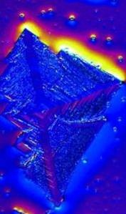
Modern Atomic Theory
Began with the work of John Dalton in the 19th century
Major Points of Atomic Theory
❶ All matter is composed of atoms.
❷ Atoms of a specific element are different from those of other elements.
❸ Atoms cannot be created or destroyed.
❹ Different atoms combine in simple whole-number ratios to form compounds.
❺ In a chemical reaction, atoms are separated, combined, or rearranged.

Slide 5
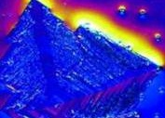
View of atom with Scanning Tunneling Microscope (STM)
Atoms are submicroscopic matter

Slide 6
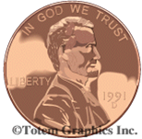
How small is an atom?
The world population in the year 2012:
7,000,000,000
The number of copper atoms in a penny:
29,000,000,000,000,000,000,000
or
2.9 x 10²²
atoms of copper

Slide 7
Development of Atomic Theory
Cathode ray experiments (1890s) detected negative particles that are part of all matter.
J.J. Thomson determined the charge-to-mass ratio of this particle and identified the electron.
In his Oil Drop Experiment (1909), Milliken calculated the charge of the electron and its mass, using the known charge-to-mass ratio.
As a result of his Gold Foil Experiment (1911), Ernest Rutherford developed the nuclear model of the atom.
http://www.mhhe.com/physsci/chemistry/essentialchemistry/flash/ruther14.swf

Slide 8
Nuclear Model of Atom
A tiny, dense center region, called the nucleus, contains all the atom’s positive charge and virtually all of its mass.
The electron cloud is mostly empty space, surrounding the nucleus, through which electrons rapidly move while held within the atom by their electrostatic attraction to the nucleus.

Slide 9
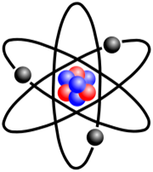
Development of Atomic Theory
In 1920, Rutherford identified the positively charged proton, which resides in the nucleus
In 1932, James Chadwick identified the neutron.

Slide 10
Subatomic Particles
The Electron
Symbol e–
Charge 1–
Location empty space outside nucleus
Actual mass 9.11 x 10^{–28} g
Relative mass 1/1840 amu
Discovered by J.J. Thomson

Slide 11
Subatomic Particles
The Proton
Symbol p⁺
Charge 1⁺
Location nucleus
Actual mass 1.673 x 10^{–24} g
Relative mass 1 amu
Discovered by Ernest Rutherford

Slide 12
Subatomic Particles
The Neutron
Symbol n⁰
Charge 0
Location nucleus
Actual mass 1.675 x 10^{–24} g
Relative mass 1 amu
Discovered by James Chadwick

Slide 13
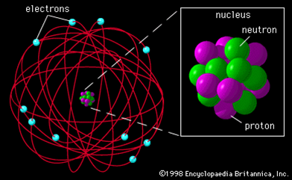
The Atom
Centrally located, dense nucleus surrounded by mostly empty space called the electron cloud

Slide 14
Atomic Structure
Section 4.3

Slide 15
Atomic Structure
Atoms make up elements
Elements: pure substances that cannot be broken down into simpler substances
Discovery of 118 elements have been reported
Elements are organized in the modern periodic table
The atoms in an element are similar to each other and different from those of all other elements

Slide 16
Atomic Number
Periodic Table (PT) provides information about each element and organizes the elements in order of increasing atomic number
The atomic number appears below the element name on the periodic table
Equal to the number of protons, which is equal to
the number of electrons
Protons → identity of the element
Electrons → chemical properties & behavior of atoms
Atomic Number = # of protons = # of electrons
Element symbol is beneath name and atomic number, followed by atomic mass
Silicon

14
Si
28.086

Slide 17
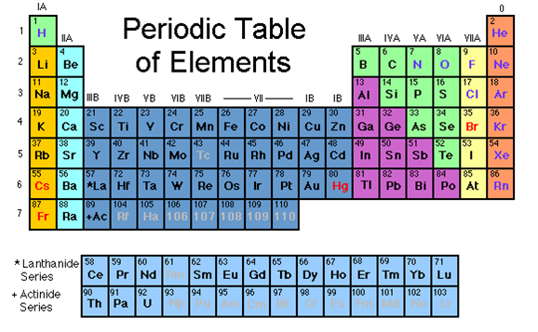
Concept Check

Slide 18
Isotopes
The number of neutrons in an atom of a particular element is not always the same

Slide 19
Isotopes
Definition
Isotopes are atoms of the same element that have a different number of neutrons
Same identity, different masses
Same number of protons and electrons, different number of neutrons
Therefore, neutrons are responsible for the isotopes (or different forms) of an atom

Slide 20
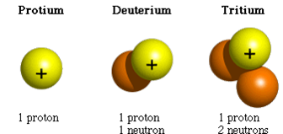
Isotopes
Isotopes can be identified by writing the mass number after the element name or symbol
Hydrogen-1
H-1
Hydrogen-2
H-2
Hydrogen-3
H-3

Slide 21
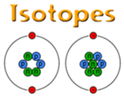
☑Concept Check

Slide 22
Mass of the Atom
The mass of the atom is made up of the protons and neutrons in the nucleus
The mass of the electron is insignificant
Mass Number = # of p⁺ + # of n⁰
Mass Number
Always a whole number
Can be used with atomic number to calculate the number of neutrons
# of n⁰ = Mass Number – # of p⁺
(AKA atomic #)

Slide 23
Mass Number
Mass number does not indicate the actual mass of atom
Mass of atoms measured in grams is extremely small
More useful to work with relative atomic mass
Mass of an atom expressed in atomic mass units (amu)
Mass of one atom in relationship to mass of another (C-12)
1 amu = one twelfth (1/12) the mass of one atom of carbon-12
One amu is nearly equal to the mass of a proton or neutron

Slide 24
Average Atomic Mass
Average atomic mass is the weighted average mass of the naturally occurring isotopes of an element
Isotopes existing in greater abundance have a greater effect in determining the average atomic mass
Not usually expressed in whole numbers but are numbers with decimal places
Appears below the symbol for the element on the PT

Slide 25
Average Atomic Mass
In most cases, rounding the average atomic mass, found on the PT, to the nearest whole number gives the mass number for the most abundant (or most common) isotope of the element
Manganese (Mn): atomic mass = 54.9 amu
Round to nearest whole number = 55 amu
Most abundant isotope of manganese = Mn-55
Cobalt (Co): atomic mass = 58.9 amu
Round to nearest whole number = 59 amu
Most abundant isotope of cobalt = Co-59

Slide 26
Average Atomic Mass
Average atomic mass can be calculated when given mass of isotope and percent abundance of an element’s naturally occurring isotopes
Avg atomic mass = (mass of isotope₁)(% as decimal)
+ (mass of isotope₂)(% as decimal)
+ (mass of isotope₃)(% as decimal)
etc.

Slide 27
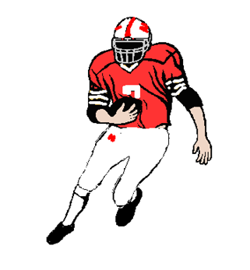
Average Atomic Mass
Find the weighted average mass of a football team if 92.0% of the players weigh 200. lbs. and 8.00% weigh 180. lbs.
Avg mass = (200. lbs)(.920) + (180. lbs)(.0800)
Avg mass = 184 lbs + 14.4 lbs
Avg mass = 198.4 lbs
Avg mass = 198 lbs to 3 SF

Slide 28
Average Atomic Mass
Two naturally occurring isotopes of copper: Cu-63 and Cu-65.
Cu-63: 69.2%, 62.9 amu
Cu-65: 30.8%, 64.9 amu
Avg mass = (62.9 amu)(.692) + (64.9 amu)(.308)
Avg mass = 63.516 amu
Avg mass = 63.5 amu to 3 SF

Slide 29
Isotope Names
6
All carbon atoms contain ____ protons because ________________________.
One isotope of carbon contains eight neutrons, giving it a mass number of ____.
The isotope name for this isotope of carbon is written as:
The carbon isotope containing seven neutrons is ______________ or _____.
carbon is atomic number 6
14
Carbon-14 of C-14
Carbon-13
C-13

Slide 30
Isotopic Notation
Isotopic notation or isotope symbol uses the element symbol, atomic number and mass number
Sometimes atomic number
is omitted
Atomic number:
Number of protons:
Number of electrons:
Number of neutrons:
14
C
6
6
6
6
8

Slide 31
Charged Particles
The nucleus of an atom has a positive charge. Why?
Electrons are negatively charged. Why is the atom electrically neutral?
Definition of ion:
Charged atom, resulting from the loss or gain of electrons

Slide 32
Ions
Anion
Negatively charged ion due to the gain of electrons (nonmetals)
EXAMPLE
F Atomic # 9 = _____ electrons
F– gained one electron = _____ electrons
9
10
9p⁺
9e⁻
9p⁺
10e⁻

Slide 33
Ions
Cation
Positively charged ion due to the loss of electrons (metals)
EXAMPLE
Mg Atomic # 12 = _____ electrons
Mg²⁺ lost two electrons = _____ electrons
12
10
12p⁺
12e⁻
12p⁺
10e⁻

Slide 34
Isotopic Notation
Isotopic notation for ions show the charge in addition to the symbol, atomic number and mass number
mass number
charge
23
Na⁺
11
atomic number
symbol

