Slide 1
Electrons in the Atom
Quantum Mechanical Model

Slide 2
Electromagnetic Radiation
One way energy travels through space
Light from sun
Medical X-rays
Microwaves
Radio and television waves
Visible light (ROYGBIV)
Classified by wavelength
Small part of the electromagnetic spectrum

Slide 3
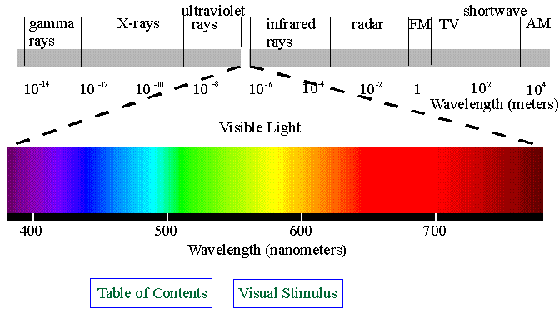
Electromagnetic Radiation

Slide 4
Light
Has wavelike properties and behavior
Also behaves like a stream of particles
Photon: tiny packet of energy
Atoms also radiate light energy
At high temperatures or when subjected to high voltages of electricity, gaseous atoms give off energy perceived as colored light

Slide 5
Bohr Model
Niels Bohr experimented with hydrogen
Proposed the Bohr model of the atom
Electrons travel in circular orbits around nucleus in discrete energy levels
Each orbit represents different amount of energy
When electricity was added to hydrogen and it was viewed through a spectroscope, a pattern of lines was seen that was different from other elements
Model later proved incorrect
Hydrogen is monoelectronic

Slide 6
Bohr Model
1st Energy Level
2nd Energy Level
3rd Energy Level
4th Energy Level
Nucleus

Slide 7
Bohr Model
Energy of electron is quantized
Energy is emitted in small, discrete packets (quanta) rather than continuous stream
Electrons must be at one energy level or another; they cannot exist between levels
To move from one level to another, specific amounts of energy must be absorbed or released

Slide 8
Bohr Model

Slide 9
The Flame Test Lab
Simple form of spectroscopy
Used to identify elements based upon different colors of visible light emitted
Hypothesis:
Independent variable:
Dependent variable:
Relationship of independent and dependent variables
identity of metallic ion
color of flame

Slide 10
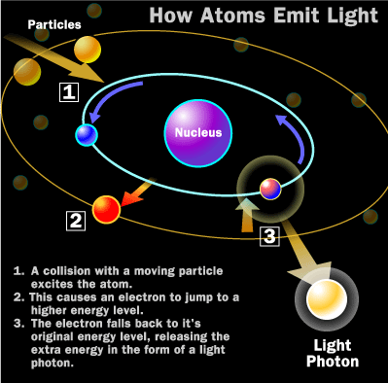

Slide 14
The Flame Test Lab
Electrons in the electron cloud of the atom are positioned in specific energy levels
Ground state: lowest energy position available
When energy is added to the atom, the electrons absorb energy
Electrons “jump” to higher energy levels and enter the excited state
Electrons cannot stay excited indefinitely and will move to lower energy levels, eventually returning to ground state

Slide 15
The Flame Test Lab
Law of Conservation of Energy
Energy cannot be created or destroyed
Energy is released as photons of light
The photons of energy are measured as the atomic emission spectrum of the element

Slide 16
Atomic Emission Spectra
Set of frequencies of electromagnetic waves emitted by the atoms of an element
Unique to each element and can be used, like a fingerprint, to identify gaseous elements
Chemical properties of element and its position in the periodic table determine electron behavior
All elements have a unique number and arrangement of electrons
AES and Periodic Table

Slide 17
Bohr’s Energy Levels
Electrons are positioned in certain energy levels
Orbits represent specific amounts of energy
Low energy levels: closer to nucleus
High energy levels: farther from nucleus
Ground state: electrons in lowest energy level possible
Electrons cannot exist between energy levels

Slide 18
Excited Atom
Atom has absorbed energy
Quantum or photon of energy is required for electron to jump to a higher level
Excited state is unstable
Atom soon emits same amount of energy absorbed
Energy seen as visible light
Small part of electromagnetic radiation spectrum

Slide 19
Modern View of Light
Light has a dual nature
Light may behave as a wave
Light may behave as a stream of particles called quanta or photons
Quantum is the minimum amount of energy that can be lost or gained by an atom

Slide 20
Spectroscopy
Spectral lines represent energy released as electron returns to lower energy state
Spectral lines identify an element
Called the atomic emission spectrum of an electron

Slide 21
Orbital
Region of space where an electron is likely to be found

Slide 22
Quantum Numbers
Four quantum numbers are n, l, m, s
Used to describe an electron in an atom
Serve as the “address” for an electron

Slide 23
Quantum Number n
Principal Quantum Number
Represents main energy level of electron
Whole numbers beginning with 1
Maximum number of electrons in an energy level = 2n²
Example: What is the maximum number of electrons that can be in the 5th energy level?
2n² = 2(5)² = 50

Slide 24
Quantum Number l
The second quantum number
Describes the orbital shape within an energy level
Number of orbital shapes possible in energy level = n

Slide 25
Orbital Shapes
Designated s, p, d, f
Level 1: s
Level 2: s, p
Level 3: s, p, d
Level 4: s, p, d, f

Slide 26
How many electrons can each sublevel hold?
An orbital can hold a maximum of two electrons, if they have opposite spins
Sublevel: one orbital or a group of orbitals with the same shape in an energy level
s = 1 orbital x 2e–/orbital = 2 e–
p = 3 orbital x 2e–/orbital = 6 e–
d = 5 orbital x 2e–/orbital = 10 e–
f = 7 orbital x 2e–/orbital = 14 e–

Slide 27
Quantum Number m
The third quantum number
Describes orientation of orbital in space

Slide 28
Quantum Number s
The fourth quantum number
Describes spin of electron in orbital
Clockwise or counterclockwise

Slide 29
Ground State
Lowest energy arrangement of electrons
Electron distribution: how electrons are distributed or arranged within energy levels and sublevels
AKA electron configuration
Examples
Hydrogen
Lithium
Nitrogen
Sum of superscripts = total number of e– in atom
1
s
¹
1
s
²
2
s
¹
1
s
2
s
2
²
²
p
³

Slide 30
Orbital Notation
Uses boxes, circles, or lines to represent orbitals
Since there is only one s orbital per energy level, one box is used
For p orbitals, three boxes are drawn
Five boxes for d orbitals and seven for f orbitals
Uses arrows to represent electrons
An up arrow (↑) represents the first electron in an orbital, spinning clockwise
A down arrow (↓) represents the second, spinning counterclockwise

Slide 31
Hund’s Rule
Orbitals of equal energy are each occupied by one electron before any orbital is occupied by a second electron

Slide 32
Pauli Exclusion Principle
No two electrons in the same atom can have the same set of four quantum numbers

