Slide 1
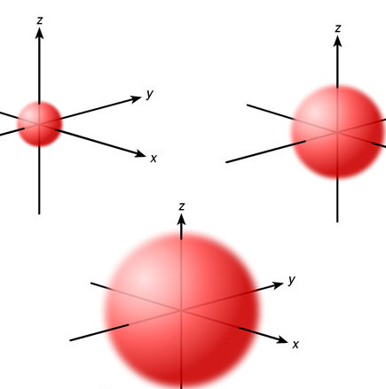
Orbitals
s orbitals are spherically shaped
There is one s orbital per level beginning with energy level 1
Orbitals further from the nucleus are larger and have higher energy

Slide 2
Orbitals
p orbitals are dumb-bell shaped
There are three p orbitals of equal energy beginning in energy level 2
Orbitals further from the nucleus are larger and have higher energy

Slide 3
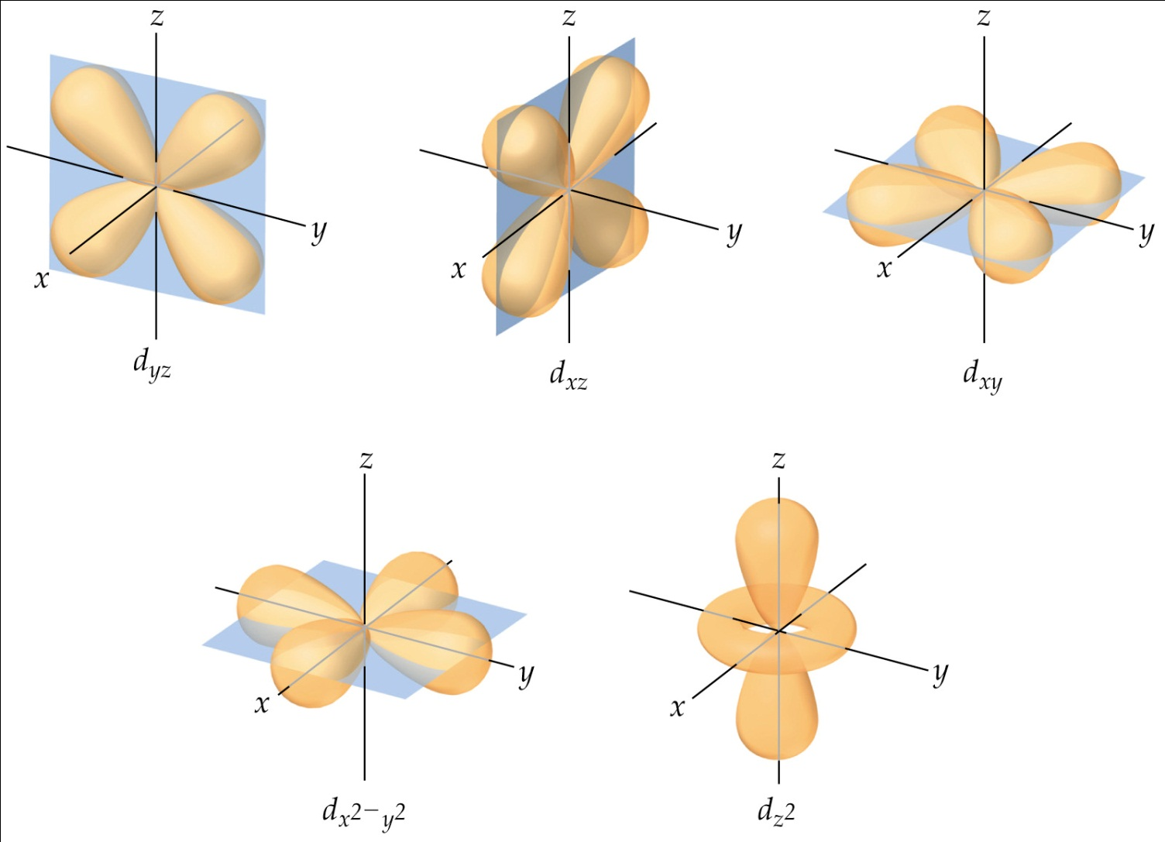
Orbitals
Five d orbitals of equal energy are present beginning with energy level 3
Four are in a cloverleaf shape while the fifth is shaped differently
Orbitals further from the nucleus are larger and have higher energy

Slide 4
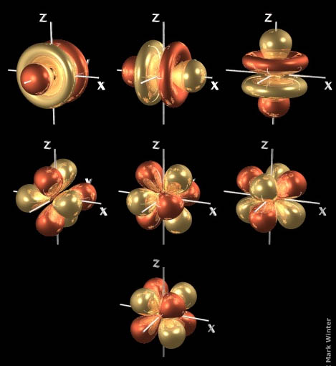
Orbitals
f orbitals are shaped differently but are of equal energy
Seven f orbitals are present beginning with energy level 4
Orbitals further from the nucleus are larger and have higher energy

Slide 5
