Slide 1
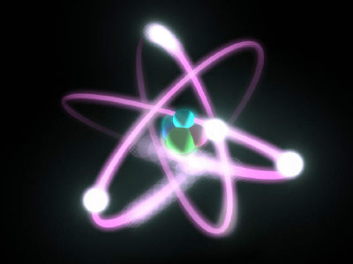
Nuclear Chemistry
Section 4.4, Chapter 24

Slide 2
Nuclear Chemistry
Chemical Rxns
Nuclear Rxns
Chemical bonds are broken and formed
Atoms are unchanged, only rearranged
Involve valence electrons
Small energy changes
Rxn rate affected by temperature, pressure, concentration, and catalysts
Nuclei emit particles and/or rays
Atoms converted to new elements
May involve p⁺, n⁰, and e–
Large energy changes
Rate not affected by temperature, pressure, or catalysts

Slide 3
What is Radiation?
Radiation or radioactive decay – substances spontaneously emit radioactive rays and particles
Radioactive isotopes (atomic number > 83) have unstable nuclei
Neutron to proton ratio is not 1:1 (too many neutrons)
Unstable nucleus decays to become more stable
Releases tremendous amount of energy
Atom forms a new element

Slide 4
Radioactivity
Decay Type | Emission | Composition | Symbol | Charge | Mass | Penetrating Power
Alpha decay | Alpha particles | Two p⁺ and two n⁰ (helium nucleus) |  | 2+ | 4 amu | Paper
Beta decay | Beta particles | Fast-moving electron |  | 1– | 0 amu | Metal foil
Gamma emission* | Gamma rays | High energy photons |  | 0 | 0 amu | Lead, concrete
₄
He
²
₀
ß
^{–1}
₀
γ
⁰
*Accompanies alpha and beta decay

Slide 5
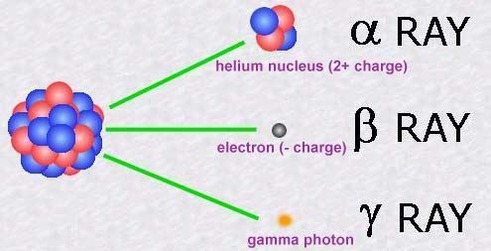

Slide 7
Balancing Nuclear Equations
Nuclear equations express nuclear reactions
Use isotopic notation
Show that atomic numbers and mass numbers are conserved
Process
Balance the number of nucleons (protons and neutrons) using mass number
Balance the charge using atomic number
Determine the decay product (alpha or beta particles) and write balanced equation

Slide 8
Nuclear Reactions
Transmutation: nuclear reaction; reaction in which atomic number (number of protons) is changed
Radioactive decay (alpha and beta)
Induced transmutation: striking nuclei with high-velocity particles to cause nuclear reaction
Elements with atomic number > 92 are considered transuranium elements
Synthetic elements
Created by induced transmutation

Slide 9
Fission
Fusion

Slide 10
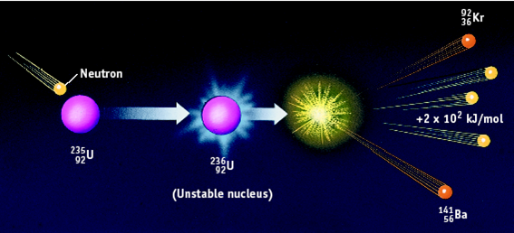
Fission
Large, unstable nucleus is bombarded by a neutron
Heavy nucleus splits into two smaller, more stable nuclei
New isotopes are formed while emitting a neutron

Slide 11
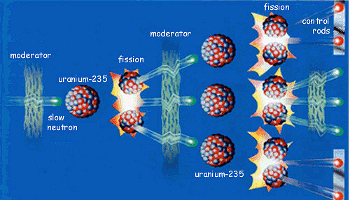
Fission
Process continues forming chain reaction
Explosion from atomic bomb results from uncontrolled chain reaction

Slide 12
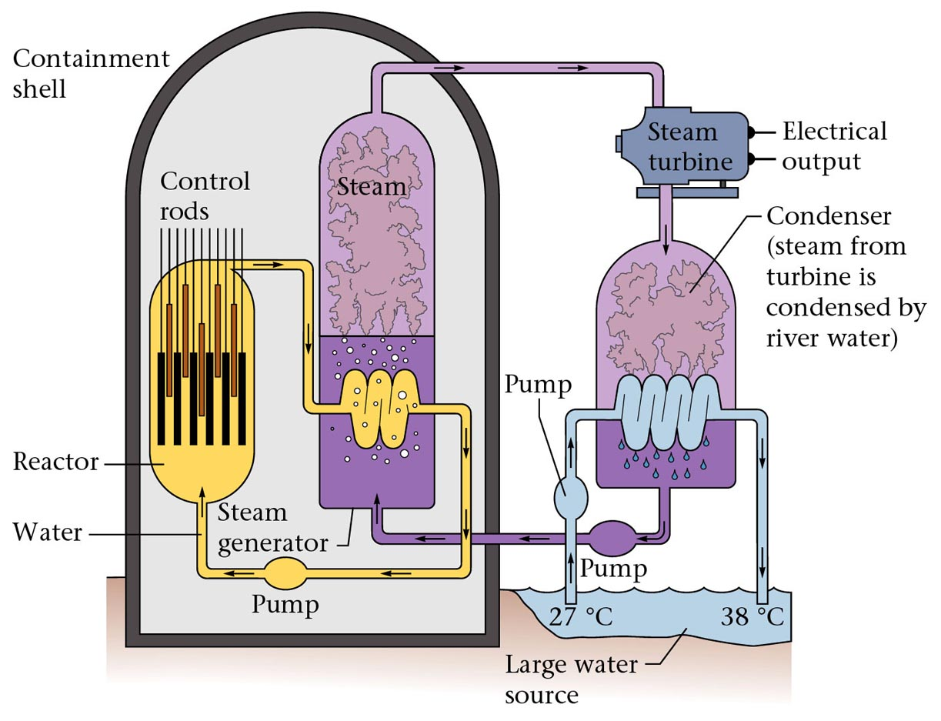
Fission in Nuclear Power Plants

Slide 13
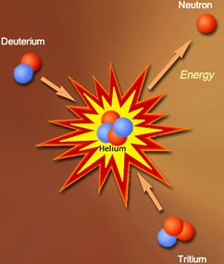
Fusion
Two small nuclei combine to form larger, more stable nucleus is nuclear fusion
Releases more energy than nuclear fission but requires extremely high temperatures
Sun and stars are powered by fusion reactions

Slide 14
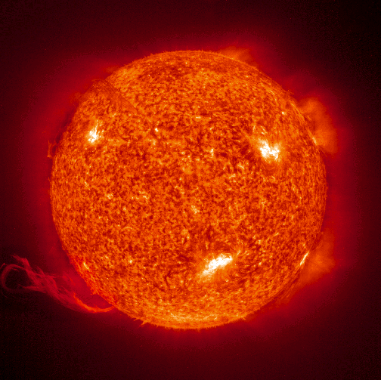
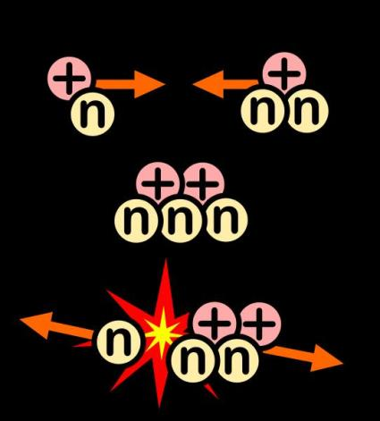
Fusion
All elements heavier than helium are formed through nuclear fusion

Slide 16
Half-Life
Radiochemical dating: process of determining the age of an object by measuring the amount of a certain radioisotope that remains
Decay rates of radioactive nuclei are constant and are referred to as the half-life of the radioisotope
Carbon-14 is used for specimens less than 20,000 years old and were once living. Potassium-40 has been used to date ancient rocks and minerals.

Slide 17
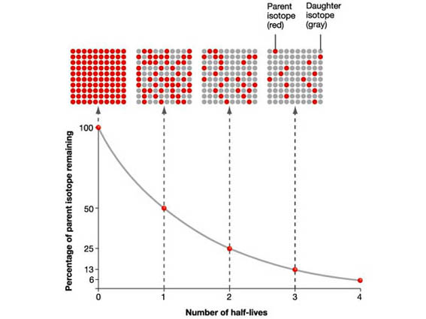
Half-Life

Slide 18
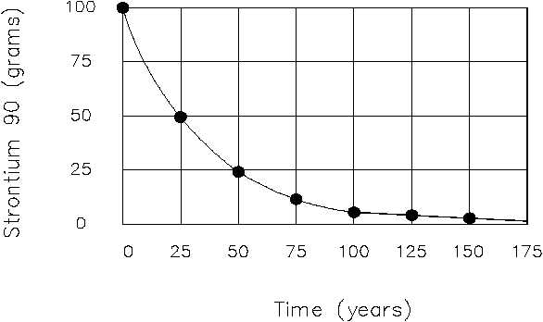
0 1 2 3 4 5 6 7
Number of Half-Lives
The half-life of strontium-90 is 29 years. If you had 100. grams today, how much Sr-90 would remain in 116 years?
How many half-lives will have passed in 116 years? 29 years → 58 years → 87 years → 116 years
4 half-lives

Slide 19
Formulas for Half-Life
Amount remaining = (Initial amount)(1/2) ^{n}
where n = number of half-lives passed
Amount remaining = (Initial amount)(1/2) ^{t/T}
where t = elapsed time and T = duration of half-life
Amt = (100. g)(1/2)⁴
Amt = 6.25 g
Amt = (100. g)(1/2)^{116 yrs/29 yrs}
Amt = 6.25 g

Slide 20
Calculating Half-Life
The half-life of strontium-90 is 29 years. If you had 100. grams today, how much Sr-90 would remain in 116 years?
# HL | Time | Amount
0 | 0 | 100. g

Slide 21
Calculating Half-Life
The half-life of strontium-90 is 29 years. If you had 100. grams today, how much Sr-90 would remain in 116 years?
# HL | Time | Amount
0 | 0 | 100. g
1 | 29 yrs | 50.0 g

Slide 22
Calculating Half-Life
The half-life of strontium-90 is 29 years. If you had 100. grams today, how much Sr-90 would remain in 116 years?
# HL | Time | Amount
0 | 0 | 100. g
1 | 29 yrs | 50.0 g
2 | 58 yrs | 25.0 g

Slide 23
Calculating Half-Life
The half-life of strontium-90 is 29 years. If you had 100. grams today, how much Sr-90 would remain in 116 years?
# HL | Time | Amount
0 | 0 | 100. g
1 | 29 yrs | 50.0 g
2 | 58 yrs | 25.0 g
3 | 87 yrs | 12.5 g

Slide 24
Calculating Half-Life
The half-life of strontium-90 is 29 years. If you had 100. grams today, how much Sr-90 would remain in 116 years?
# HL | Time | Amount
0 | 0 | 100. g
1 | 29 yrs | 50.0 g
2 | 58 yrs | 25.0 g
3 | 87 yrs | 12.5 g
4 | 116 yrs | 6.25 g

Slide 25
Add to U3-1 Classwork/Homework
The half-life of tritium or H-3 is 12 years. If you start with 200. grams of tritium, how many half-lives will have passed when only 25.0 grams remain? How much time will have passed?
# HL | Time | Amount
0 | 0 | 200. g

Slide 26
Add to U3-1 Classwork/Homework
The half-life of tritium or H-3 is 12 years. If you start with 200. grams of tritium, how many half-lives will have passed when only 25.0 grams remains? How much time will have passed?
# HL | Time | Amount
0 | 0 | 200. g
1 | 12 yrs | 100. g

Slide 27
Add to U3-1 Classwork/Homework
The half-life of tritium or H-3 is 12 years. If you start with 200. grams of tritium, how many half-lives will have passed when only 25.0 grams remains? How much time will have passed?
# HL | Time | Amount
0 | 0 | 200. g
1 | 12 yrs | 100. g
2 | 24 yrs | 50.0 g

Slide 28
Add to U3-1 Classwork/Homework
The half-life of tritium or H-3 is 12 years. If you start with 200. grams of tritium, how many half-lives will have passed when only 25.0 grams remains? How much time will have passed?
3 half-lives; 36 years
# HL | Time | Amount
0 | 0 | 200. g
1 | 12 yrs | 100. g
2 | 24 yrs | 50.0 g
3 | 36 yrs | 25.0 g

