Slide 1
Chemical Reactions
Unit 6
Chapter 9

Slide 2
Chemical Reaction
Process by which atoms of one or more substances are rearranged to form different substances
Also known as chemical change
Reactants (starting substances) react to form products (ending substances)
Products have different compositions from reactants

Slide 3
Chemical Reaction
Evidence that chemical reaction has occurred:
Formation of a GAS
Formation of a PRECIPITATE
Change in COLOR
Change in or production of ODOR
Change in MAGNETISM
Change in temperature or ENERGY
Exothermic: releases energy (temperature increases)
Endothermic: absorbs energy (temperature decreases)

Slide 4
Chemical Reaction
Represented by chemical equations
Formulas show chemistry at a standstill.
Equations show chemistry in action.
Equations show:
The reactants that enter into a reaction
The products that are formed by the reaction
The relative amounts of each substance used and produced

Slide 5
Chemical Reaction
Two important principles:
Every chemical compound has one correct formula, which cannot be altered.
A chemical reaction must obey the Law of Conservation of Matter.
In a chemical reaction, atoms are neither created nor destroyed.

Slide 6
Chemical Equations
General formula:
reactant + reactant → product + product
Physical states of substances are indicated with symbols to show how reaction occurs.
Symbols Used in Equations
Symbol | Meaning | Symbol | Meaning

Slide 7
Chemical Equations
General formula:
reactant + reactant → product + product
Physical states of substances are indicated with symbols to show how reaction occurs.
Symbols Used in Equations
Symbol | Meaning | Symbol | Meaning
+ | Separates two or more reactants or products | → | Separates reactants from products; “yields” or “forms”
(s) | Identifies solid state | (l) | Identifies liquid state
(g) | Identifies gaseous state | (aq) | Identifies aqueous (water) solution

Slide 8
Word Equations
Indicate the reactants and products in a reaction, using words.
Carbonic acid decomposes to produce water and carbon dioxide gas.
carbonic acid (aq) → water (l) + carbon dioxide (g)
Magnesium ribbon reacts with oxygen in the air to produce solid magnesium oxide.
magnesium (s) + oxygen (g) → magnesium oxide (s)
Hydrogen and oxygen gases combine to form water.
hydrogen (g) + oxygen (g) → water (l)

Slide 9
Skeleton Equations
Use chemical formulas rather than words to indicate reactants and products.
Carbonic acid decomposes to produce water and carbon dioxide gas.
H₂CO₃ (aq) → H₂O (l) + CO₂(g)

Slide 10
Skeleton Equations
Use chemical formulas rather than words to indicate reactants and products.
Magnesium ribbon reacts with oxygen in the air to produce magnesium oxide.
Mg (s) + O₂ (g) → MgO (s)

Slide 11
Skeleton Equations
Use chemical formulas rather than words to indicate reactants and products.
Hydrogen and oxygen gases combine to form water.
H₂ (g) + O₂ (g) → H₂O (l)

Slide 12
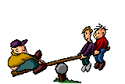
Balanced Chemical Equations
Reflect the Law of Conservation of Mass.
The number of atoms of an element on one side of the equation must equal the number of atoms of that element on the other side of the equation.

Slide 13
Balanced Chemical Equations
Carbonic acid decomposes to produce water and carbon dioxide gas.
____ H₂CO₃ (aq) → ____ H₂O (l) + ____ CO₂(g)
Balanced:
H₂CO₃ (aq) → H₂O (l) + CO₂(g)
(1)
(1)
(1)

Slide 14
Balanced Chemical Equations
Magnesium ribbon reacts with oxygen in the air to produce magnesium oxide.
____ Mg (s) + ____ O₂ (g) → ____ MgO (s)
Balanced:
2Mg (s) + O₂ (g) → 2MgO (s)
2
(1)
2

Slide 15
Balanced Chemical Equations
Hydrogen and oxygen gases combine to form water.
____ H₂ (g) + ____ O₂ (g) → ____ H₂O (l)
Balanced:
2H₂ (g) + O₂ (g) → 2H₂O (l)
2
(1)
2

Slide 16
Subscripts
Whole numbers written to the lower right of element symbols in chemical formulas
Indicate the number of atoms/ions present in one particle of a compound
A subscript of 1 is not written.
Once a correct chemical formula is written for a substance, subscripts cannot be changed

Slide 17
Coefficients
Whole numbers written in front of chemical formulas in a chemical equation
Describe the lowest whole number ratio of all reactants and products in a reaction
A coefficient of 1 is not written.
Coefficients—not subscripts—are changed to balance equations.

Slide 18
Tips for Balancing
Check and double-check chemical formulas, then check them again
Once they are correct, DON’T CHANGE THEM!
HOBrFINCl (diatomic molecules)
When a polyatomic ion appears on both sides of the equation, treat it as one unit rather than separating it into its atoms
Change coefficients—NOT SUBSCRIPTS!

Slide 19
Reactions Organizer
Unit 6

Slide 20
Types of Chemical Reactions
Synthesis
Decomposition
Single Replacement
Double Replacement
Combustion
Combustion of Hydrocarbons
Neutralization
Condensation
Photosynthesis

Slide 21
Synthesis Reactions
General formula—
A + B → AB
A compound is formed between:
Two elements
An element and a compound
Two compounds

Slide 22
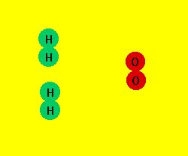
Example of Synthesis
Find two other examples of synthesis reactions

Slide 23
Decomposition Reactions
General formula—
AB → A + B
A compound breaks apart to create:
Two elements
An element and a compound
Two or more compounds

Slide 24
Example of Decomposition
Example of Decomposition
2
KClO₄ → KCl + O₂

Slide 25
Decomposition Reactions
Find two other examples of decomposition reactions.

Slide 26
Single Replacement Reactions
General formula—
A + BC → AC + B
Involves substitution of one element for another in a compound
Activity series: more active elements appear higher in series and will replace less active elements, appearing lower in series (p. 293)

Slide 27
Activity Series

Slide 28
Single Replacement Reactions
General formula—
A + BC → AC + B
Involves substitution of one element for another in a compound
Activity series: more active elements appear higher in series and will replace less active elements, appearing lower in series (p. 293)
AKA single displacement reactions
Example
CuSO₄ (aq) + Zn (s) → Cu (s) + ZnSO₄ (aq)

Slide 29
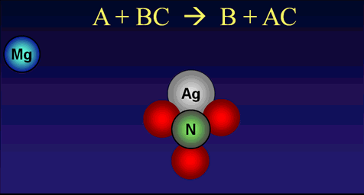
Example of Single Replacement
2
2
Mg (s) + AgNO₃ (aq) → Ag (s) + Mg(NO₃)₂(aq)

Slide 30
Single Replacement Reactions
Predict the products.
Ni(NO₃)₂(aq) + Mg (s) →

Slide 31
Single Replacement Reactions
Predict the products.
Ni(NO₃)₂(aq) + Mg (s) → Ni (s) + Mg(NO₃)₂(aq)
AlSO₄ (aq) + Pt (s) →

Slide 32
Single Replacement Reactions
Predict the products
Ni(NO₃)₂(aq) + Mg (s) → Ni (s) + Mg(NO₃)₂(aq)
AlSO₄ (aq) + Pt (s) → NR

Slide 33
Single Replacement Reactions
Predict the products
Ni(NO₃)₂(aq) + Mg (s) → Ni (s) + Mg(NO₃)₂(aq)
AlSO₄ (aq) + Pt (s) → NR
Cl₂ (g) + KI (aq) →

Slide 34
Single Replacement Reactions
Predict the products
Ni(NO₃)₂(aq) + Mg (s) → Ni (s) + Mg(NO₃)₂(aq)
AlSO₄ (aq) + Pt (s) → NR
Cl₂ (g) + KI (aq) → I₂ (s) + KCl (aq)
2
2

Slide 35
Single Replacement Reactions
Predict the products
Ni(NO₃)₂(aq) + Mg (s) → Ni (s) + Mg(NO₃)₂(aq)
AlSO₄ (aq) + Pt (s) → NR
Cl₂ (g) + KI (aq) → I₂ (s) + KCl (aq)
I₂ (s) + NaF (aq) →
2
2

Slide 36
Single Replacement Reactions
Predict the products
Ni(NO₃)₂(aq) + Mg (s) → Ni (s) + Mg(NO₃)₂(aq)
AlSO₄ (aq) + Pt (s) → NR
Cl₂ (g) + KI (aq) → I₂ (s) + KCl (aq)
I₂ (s) + NaF (aq) → NR
2
2

Slide 37
Double Replacement Reactions
General formula—
AB + CD → AD + CB
Two compounds react to form two new compounds by exchanging anions
Reactants are acids or ionic compounds, usually in aqueous solution
Water or gas is produced, or insoluble products precipitate out of solution
AKA double displacement reactions
Example
Ca(OH)₂ (aq) + HCl (aq) → CaCl₂ (aq) + H₂O(l)
2
2

Slide 38
Example of Double Replacement
Na
O
H
Cl
Cl
Fe
Na
O
H
Cl
Na
O
H
3
3
NaOH + FeCl₃ → NaCl + Fe(OH)₃

Slide 39
Combustion Reactions
General formula—
A + O₂ → AO
Oxygen is a reactant and an oxide is produced
Energy is released in the forms of heat and light

Slide 40
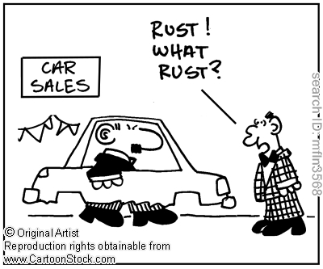
Examples of Combustion
4
3
Fe + O₂ → Fe₂O₃
2
2

Slide 41
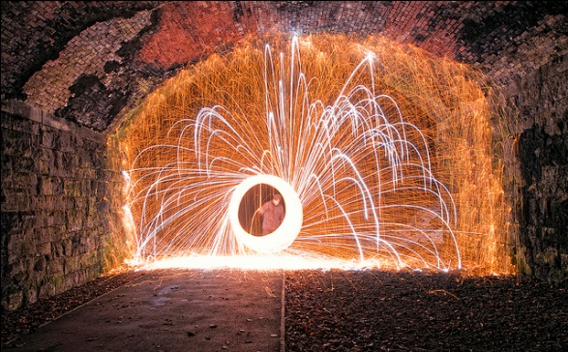
Examples of Combustion
Mg + O₂ → MgO
2
2

Slide 42
Combustion of Hydrocarbons
General formula—
Hydrocarbon + O₂ (g) → CO₂ (g) + H₂O (g)
Hydrocarbons in fossil fuels are combined with oxygen at high temperatures (burning of fuels)

Slide 43
Combustion of Hydrocarbons
General formula—
Hydrocarbon + O₂ (g) → CO₂ (g) + H₂O (g)
Always produce carbon dioxide and water vapor

Slide 44
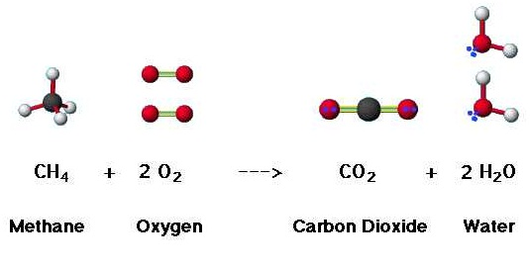
Combustion of Methane

Slide 45
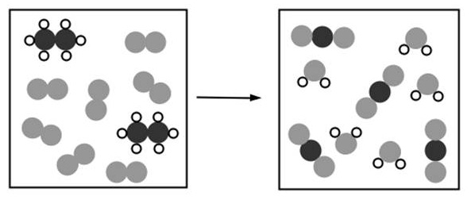
Combustion of Ethane
ethane + oxygen → carbon dioxide + water
2
3.5
4
3
C₂H₆ (g) + O₂ (g) → CO₂ (g) + H₂O (g)
7
2
6

Slide 46
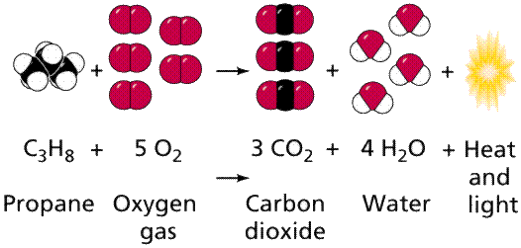
Combustion of Propane

Slide 47
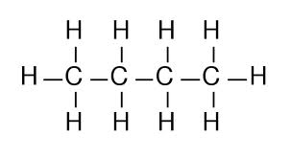
Combustion of Butane
+
→
+
butane + oxygen → carbon dioxide + water
4
10
2
5
C₄H₁₀ (g) + O₂ (g) → CO₂ (g) + H₂O (g)
13
6.5
8

Slide 48
Neutralization Reactions
Reaction of an acid with a base to produce water and an ionic salt
Acid + Base → Water + Salt
(double replacement)

Slide 49
Neutralization Reactions
Predict the products.
HClO + KOH →

Slide 50
Neutralization Reactions
Predict the products.
HClO + KOH → H₂O +

Slide 51
Neutralization Reactions
Predict the products.
HClO + KOH → H₂O + KClO
HNO₃ + NaOH →

Slide 52
Neutralization Reactions
Predict the products.
HClO + KOH → H₂O + KClO
HNO₃ + NaOH → H₂O +

Slide 53
Neutralization Reactions
Predict the products.
HClO + KOH → H₂O + KClO
HNO₃ + NaOH → H₂O + NaNO₃
H₂SO₄ + Mg(OH)₂ →

Slide 54
Neutralization Reactions
Predict the products.
HClO + KOH → H₂O + KClO
HNO₃ + NaOH → H₂O + NaNO₃
H₂SO₄ + Mg(OH)₂ → H₂O +

Slide 55
Neutralization Reactions
Predict the products.
HClO + KOH → H₂O + KClO
HNO₃ + NaOH → H₂O + NaNO₃
H₂SO₄ + Mg(OH)₂ → H₂O + MgSO₄

Slide 56
Neutralization Reactions
Predict the products.
HClO + KOH → H₂O + KClO
HNO₃ + NaOH → H₂O + NaNO₃
H₂SO₄ + Mg(OH)₂ → 2H₂O + MgSO₄

Slide 57
Condensation Reactions
Two small organic molecules combine to form a complex macromolecule (synthesis)
Accompanied by the loss of a small molecule, such as water or ammonia
Three types:
Carbohydrate formation
Protein formation
Lipid formation
short-term energy storage
enzymes, structural components
long-term energy storage

Slide 58
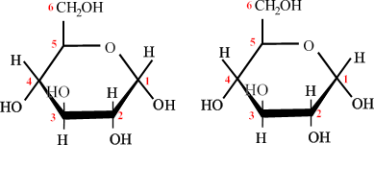
Carbohydrate Formation
Complex carbohydrates (polysaccharides) are polymers of simple sugars (monosaccharides)

Slide 59
Protein Formation
Proteins are long chains of amino acids (contain amine groups involving nitrogen) joined by peptide bonds forming polypeptides

Slide 60
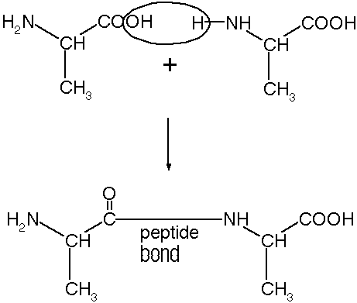
Protein Formation
The synthesis of proteins
H₂O

Slide 61
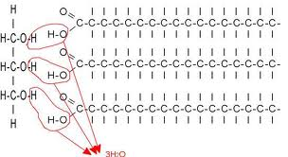
Lipid Formation
The formation of lipids (triglycerides) from three fatty acids and glycerol

Slide 62
Photosynthesis
Complex process that converts energy from sunlight to chemical energy in the bonds of carbohydrates
Occurs in plants and some algae, taking place in chloroplasts using chlorophyll
Complementary process of cellular respiration

Slide 63
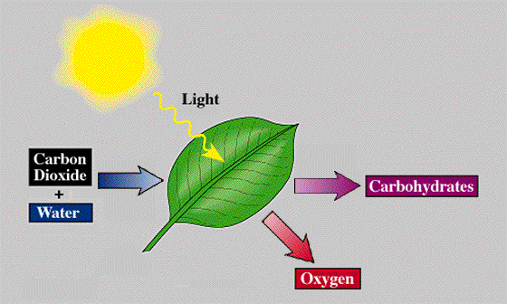
Photosynthesis
CO₂ + H₂O + sunlight → C₆H₁₂O₆ + O₂
6
6
6

